Slide 1
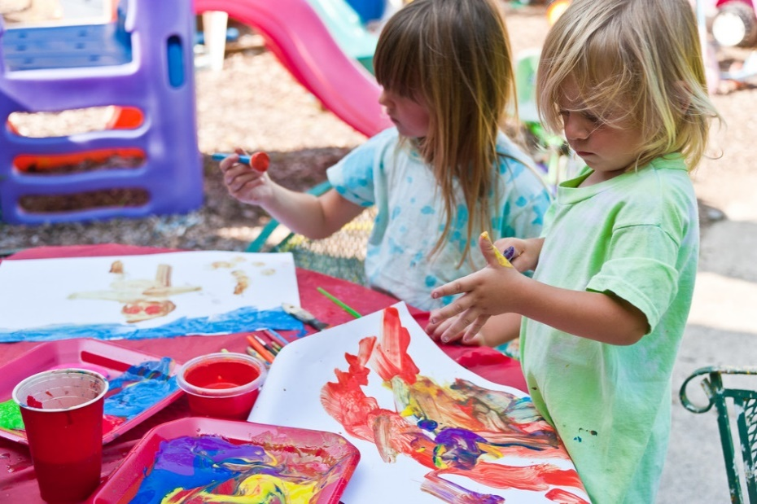
Expressive Arts and Design
Early Years Expectations: Reception
Educational Programme:
The development of children’s artistic and cultural awareness supports their imagination and creativity. It is important that children have regular opportunities to engage with the arts, enabling them to explore and play with a wide range of media and materials. The quality and variety of what children see, hear and participate in is crucial for developing their understanding, self-expression, vocabulary and ability to communicate through the arts. The frequency, repetition and depth of their experiences are fundamental to their progress in interpreting and appreciating what they hear, respond to and observe.

Slide 2
Early Years Expectations: Reception
Expressive Arts and Design | Creating with Materials
Early Learning Goal: Expressive Arts and Design | Creating with Materials
Children at the expected level of development will: Safely use and explore a variety of materials, tools and techniques, experimenting with colour, design, texture and form Share their creations, explaining the process they have used Make use of props and materials when role playing characters in narratives and stories
Progression towards the Early Learning Goal |  | Progress in other areas of curriculum – Reception
R+ | By the end of the Summer term and to be year 1 ready children should be able to…
Come up with their own design briefs to solve problems including making props and scenery for imaginative play Be able to talk through from designing to building what they have used and why they have chosen to use that resource or technique Be able to use shapes and colour to express emotions within creations Create collaborative creations sharing ideas , resources and skills for specific purposes including to complement role play |  | Be able to draw a face containing the main parts of a face and for it to reflect themselves Explore making colours lighter and darker by adding black and white to make colours lighter and darker
R= | By the end of the Spring term children should be able to…
Begin to follow a ‘design brief’ given by the teacher to create models and pictures using a range of resources Choose the most appropriate way to make their idea following a ‘design’ that they have produced to meet a given purpose Go back to their designs and improve these building on their previous learning Explore ways of joining materials for different purposes Draw with increasing complexity including beginning to add additional shapes for detail |  | Explore colour mixing from the primary colours to make new colours Know the three primary colours and begin to recreate art by well-known artists
R- | By the end of the Autumn Term children should be able to…
Create pictures and models using a range of resources from their own ideas Be able to talk about what they have made and why they have made it Explore a range of materials in their environment and make things with these, describing why they have chosen what they have chosen. Create closed shapes with continuous lines and begin to use these shapes to represent objects |  | Hold a pencil using a comfortable grip and explore different pencil types Begin to make observational drawings linked to the world around them

Slide 3
Early Years Expectations: Reception
Expressive Arts and Design | Being Imaginative and Expressive
Early Learning Goal: Expressive Arts and Design | Being Imaginative and Expressive
Children at the expected level of development will:
Invent, adapt and recount narratives and stories with peers and their teacher;
Sing a range of well-known nursery rhymes and songs; Perform songs, rhymes, poems and stories with others, and – when appropriate – try to move in time with music.
Progression towards the Early Learning Goal Progress in other areas of Being Imaginitive curriculum – Reception
R+ By the end of the Summer term and to be year 1 ready children should be able to…
Singing: Singing:
Able to sing a song / rhyme that has been taught – pitch and melody matching appropriate to the age of the child
Able to perform a simple poem (as part of a group), able to follow the rhythm of the poem
Invent own simple songs and rhymes – based on known versions
Sing a known song to an audience
Musical Knowledge and Skills:
Musical Knowledge and Skills:
Know the names of key musical instruments available to them – maraca, tambourine and triangle
Listen to a range of music and begin to compare it – ‘they sound a bit similar because they both have lots of quiet sounds’.
Begin to know types of music which they like (e.g. pop, classical, Jazz)
Able to make own simple repeating compositions (clapping / body percussion / instrument)
Able to copy a simple beat pattern X X - - X – including with instruments
Able to play an allocated instrument(s) as part of a planned musical composition
Dance:
Able to move in time with music to partake in a simple dance routine, with repetitive dance motifs
Imaginative Narrative:
Use free choice props and small world artefacts to create or adapt a narrative or story, mirroring some vocabulary, or themes from the stories they have experienced.
As part of a group, invent or adapt a known story to create a new narrative
Dance:
Create own simple dance motifs in response to music – using props / costumes as appropriate
Imaginative Narrative:
Can retell a story to an audience, using simple prompts / reminders if required
R= By the end of the Spring term children should be able to…
Singing:
Singing:
Able to pitch match in simple call and response tasks
Able to sing taught songs with melody matching
With support, adapt simple songs and rhymes
Perform a known rhyme to an audience
Musical Knowledge and Skills:

Slide 4
Know which instrument to use for a desired effect – e.g. sleigh bells for Santa, Use appropriate vocabulary to describe these sounds. Able to use instruments to match a simple taught rhythm and able to make up own musical patterns Dance: Children afforded the opportunity to freely respond to music through dance and the use of simple props (e.g. scarves, a ribbon) Children move to a beat – matching movements to the rhythm Imaginative Narrative: Use free choice props and small world artefacts to retell aspects of a story that has been experienced several times, mirroring some vocabulary from the story, with support from an adult. |  | Musical Knowledge and Skills: Listens to a range of music types express a preference and justify it with a simple statement ‘I don’t like that music because it is too loud’. Dance: Begin to create own dance motifs with support Imaginative Narrative: Retell a story as part of a group performance
R- | By the end of the Autumn Term children should be able to…
Singing: Know the difference between singing and shouting Able to join in with songs that have been taught Join in with the taught nursery rhyme/number rhyme for this term Musical Knowledge and Skills: Explore and play with a range of musical instruments – being able to match the sound to the instrument following play opportunities. Describe these sounds (rattle, loud bang, bells etc) Listens to a range of music types – recognise that they are different and express a preference Dance: Copy a simple taught dance to music – watching and matching Children able to freely respond to music through dance Children recognise the value of costume in a dance presentation Imaginative Narrative: Join in with refrains from stories Use pre-selected props and small world artefacts to retell aspects of a story that has been experienced several times, with prompting support from an adult. |  | Singing: Enjoy singing songs and rhymes – demonstrated by having favourites Memorise the songs and rhymes taught Take part in our Christmas performance – singing as part of a group to an audience Musical Knowledge and Skills: Recognise and clap the syllables in words – in preparation for pulse work Dance: Take part in our Christmas performance – dancing / moving as part of a group to an audience Imaginative Narrative: Able to choose an object and make up simple statements about it (e.g. a stick could be a magic wand that belongs to a fairy, a snake that has died, a witches finger!)

Slide 5
Reception Tracking Support
Our curriculum is the progression model. If the curriculum is well planned and progressive – and children learn the planned curriculum, then they are making progress – they know and remember more. As such, our tracking for children across is early years is simple… are they learning the planned curriculum? And if not, at what point are they up to?
A child who is learning the planned curriculum as expected would simply follow:
By Christmas | R- | A child who has kept pace with the planned curriculum by the end of the year , would achieve the national Early Learning Goals
By Easter | R=
By End Of Year | R+
Using this methodology, a child who enters reception with typical levels of knowledge and skill expected for their age would be baselined as N2+ (meeting the demands of the N2 curriculum). Children who are not displaying age appropriate skills can be assessed at any point on the scale opposite. In essence, each ‘grade’ represents a term’s worth of curriculum content. The OFSTED – and school - expectation is that most children who enter below, but not significantly below, should catch up with good teaching.

