Slide 1
Early Years Expectations
Nursery

Slide 2
Introduction
“Every child deserves the best possible start in life and support to fulfil their potential. A child’s experience in the early years has a major impact on their future life chances. A secure, safe and happy childhood is important in its own right and it provides the foundation for children to make the most of their abilities and talents as they grow up”
Early Years Foundation Stage Profile – Department for Children, Schools and Families 2012.
The Early Years Foundation Stage (EYFS) applies to children from birth to the end of reception year. At Lockwood Primary School, children are admitted into nursery in the term that they are three (when possible) and into reception in the September following their fourth birthday.
Early childhood is the foundation on which children build the rest of their lives. At Lockwood, we greatly value the importance that the EYFS plays in laying secure foundations for future learning and development.
However, we also believe that early childhood is valid in itself as part of life. It is important to view the EYFS as preparation for life and not simply preparation for the next stage of education.
When thinking about Early Years we need to have these four principles at the forefront of what we do
Every child is a unique child, who is constantly learning and can be resilient, capable, confident and self-assured
Children learn to be strong and independent through positive relationships
Children learn and develop well in enabling environments, in which their experiences respond to their individual needs and there is a strong partnership between practitioners and parents and/or carers.
Children develop and learn in different ways and at different rates.
We fully embed the three Characteristics of Effective Teaching and Learning -
playing and exploring - children investigate and experience things, and ‘have a go’
active learning - children concentrate, keep on trying if they encounter difficulties, and enjoy achievements
creating and thinking critically - children have and develop their own ideas, make links between ideas, and develop strategies for doing things.

Slide 3
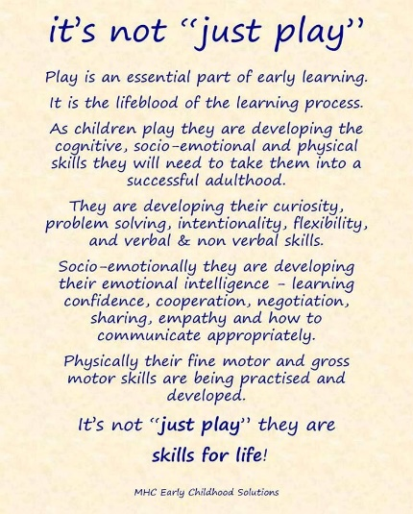
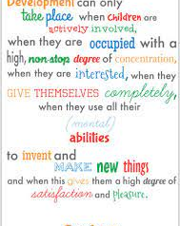
At Lockwood, we aim to support children to become independent and collaborative leaners. We will provide a broad and balanced curriculum that caters for all children’s needs and respects children’s interests and stages of development.
At Lockwood, children within EYFS are provided with a stimulating learning environment which encourages independent learning through play – a fundamental part of early learning. (Continuous Provision – this is enhanced as necessary.)

Slide 4
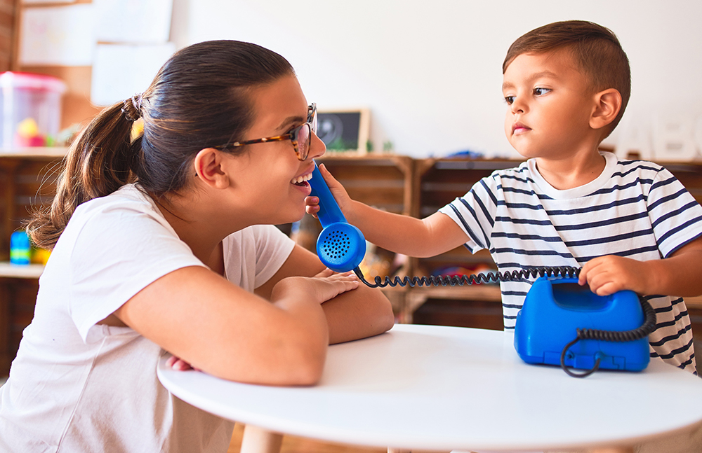
Communication and Language
Early Years Expectations: Nursery
Educational Programme:
The development of children’s spoken language underpins all seven areas of learning and development. Children’s back-and-forth interactions from an early age form the foundations for language and cognitive development. The number and quality of the conversations they have with adults and peers throughout the day in a language-rich environment is crucial. By commenting on what children are interested in or doing, and echoing back what they say with new vocabulary added, practitioners will build children's language effectively. Reading frequently to children, and engaging them actively in stories, non-fiction, rhymes and poems, and then providing them with extensive opportunities to use and embed new words in a range of contexts, will give children the opportunity to thrive. Through conversation, story-telling and role play, where children share their ideas with support and modelling from their teacher, and sensitive questioning that invites them to elaborate, children become comfortable using a rich range of vocabulary and language structures.

Slide 5
Early Years Expectations: Nursery
Communication and Language
Area of Learning : Communication and Language
Summer Term N2 (N2+) By the end of the Summer term N2 children should be able to…
• Enjoy listening to longer stories and can remember much of what happens • Be able to sing a selection of simple nursery rhymes all the way through e.g., Twinkle, Twinkle Little Star, Humpty Dumpty, Baa, Baa Black Sheep, Incy Wincy Spider • Foster a love of a variety of stories, poems, songs and rhymes • Attend to, listen and respond appropriately in a range of situations (one to one, small group or whole class) with adults and/or their peers. • To be able to understand and follow adult directions in a range of contexts, e.g. ‘Give me your attention please. It’s time to stop and tidy up’ • Use a wider range of vocabulary linked to curriculum and experiences • Show an ability to follow instructions, concentrate, think and extend ideas • Show an understanding of prepositions, such as under, on top, behind by carrying out an action or selecting correct picture • Understand ‘who’, ‘how’ and ‘why’ questions, such as ‘Why do you think the caterpillar got so fat?’, and give an explanation • Develop their pronunciation but may have problems saying: - sounds: r,j,th,ch and sh • Speak clearly in a sentence using 4-6 words consistently • Be able to use language in recalling past experiences • Use talk to explain what is happening and organise themselves in their play, e.g. ‘Let’s go on a bus…you be the driver…I’ll sit here’ • Begin to use a range of tenses (e.g. play, playing, will play, played) • Develop their communication, recognising some age-appropriate errors in language (e.g. swimmed, runned) and will absorb and use language they hear around them in their community and culture • Be able to express a point of view and to debate when they disagree with an adult / friend, using words as well as actions • Start a conversation with an adult / friend and continue it for many turns • Begin to use some expression in their conversations • Begin to recognise ‘waiting your turn’ in a conversation when someone else is speaking • Understand a question or instruction that has 2 parts, such as ‘Get your coat and wait at the door’.
Spring Term N2 (N2=) By the end of the Spring term N2 children should be able to…
• Listen and engage with an unknown short story in a small group , e.g. commenting on the illustration • Join in with repeated refrains and anticipates key events and phrases in rhymes and stories • Focus attention (in self chosen activities) – can still listen or do, but can change their own focus of attention • Understand the use of, and vocabulary related to, tools / objects, e.g. ‘Which one do we cut with?’ or ‘what would help us to move this sand?’ • Respond to instructions with more elements, e.g., ‘Give the big ball to me; collect up all the blocks and put them in the box’. • Use language to share feelings, experiences and thoughts • Begin to hold a conversation but might jump from topic to topic • Learn new words quickly and begin to be able to use them in communicating (links to topics, e.g., flower, leaf, petal)

Slide 6
• Begin to use a variety of questions e.g. what, where, can • Begin to use longer sentences, e.g. ‘I hurt my finger…’ (and what on) • Retell a simple past event in correct order e.g. ‘went down slide, hurt my finger’
Autumn Term N2 (N2-) By the end of the Autumn Term N2 children should be able to…
• Listen to familiar stories with increasing attention and engagement • to others in one-to-one or small groups, when conversation interests them • Single channelled attention; shift to a different task if their attention is fully obtained – using a child’s name helps them to focus • Join in with simple repeated refrains in rhymes, songs and stories • Understand who & what in simple questions, e.g. ‘Who’s that?’ ‘Who can…?’ ‘What’s that?’ • Name everyday objects, e.g., scissors, ball, hat, coat, book • Respond to instructions with more elements, e.g., ‘Give the big ball to Tom’ • Begin to ask simple questions e.g ‘Can I have a turn?’, ‘Where’s my picture?’ • Begin to talk about people and things that are not present, e.g. ‘my nana has a dog’
END OF N1 CHECKPOINTS (N1+) By the end of N1 children should be able to…
• Begin to talk / share / sing in a range of familiar situations or group • Listen to and enjoy rhythmic patterns in rhymes and stories, trying to join in with actions or vocalisations • Listen with interest and respond to alliterative phrases/voice sounds within stories, e.g ‘Boo!’, ‘Wheeeeeee!’ • Learn nursery rhymes and simple songs. Repeat and sing daily. • Understand simple sentences e.g. ‘Sam, throw the ball’ • Identify action words by following simple instructions, e.g., ‘Can you jump like a frog?’ • Developing understanding of simple concepts, e.g. fast / slow, hot / cold • To listen and respond to an adult instruction, with supportive gesture, e.g. ‘stop’, ‘hold my hand’, ’come to the carpet’ • Use different types of everyday words (nouns, verbs and adjectives, e.g. banana, go, sleep, soft & colours) • Pay attention to own choice of activity for a more sustained period of time, to complete a chosen task • Recognise and respond to many familiar sounds, e.g., turning to a knock on the door, looking at or going to the door • Show interest in playing with sounds, songs and rhymes • Select familiar objects by name and will go and find objects when asked, or identify objects from a group • Copy actions from words, e.g., stop, clapping, jumping • Understand ‘where’ in simple questions, e.g., ‘Where is…?’ • Use different types of everyday words (nouns, e.g. bike, dog, coat) and begin to use correctly in context • Put words together to communicate and / or express needs, e.g., ‘More juice’ ’I want my mummy’ ‘I play with teddy’
If children are not meeting the demands of these statements at the end of N1, how far behind are they? One term (N1=), two terms (N1-) or working on earlier skills from Development Matters in the Birth to 3 (B, B-, B=, B+). A child who completes 5 terms of nursery, would be seen as on track if recorded as N1= at Easter of N1.

Slide 7
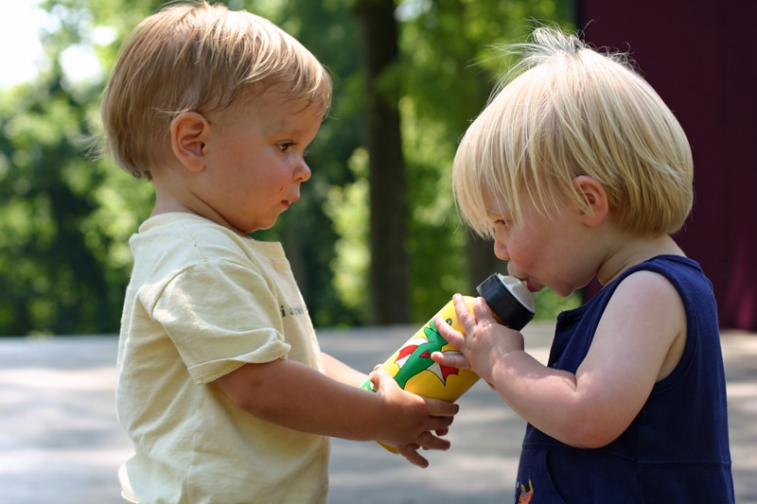
Personal, Social and Emotional Development
Early Years Expectations: Nursery
Educational Programme:
Children’s personal, social and emotional development (PSED) is crucial for children to lead healthy and happy lives, and is fundamental to their cognitive development. Underpinning their personal development are the important attachments that shape their social world. Strong, warm and supportive relationships with adults enable children to learn how to understand their own feelings and those of others. Children should be supported to manage emotions, develop a positive sense of self, set themselves simple goals, have confidence in their own abilities, to persist and wait for what they want and direct attention as necessary. Through adult modelling and guidance, they will learn how to look after their bodies, including healthy eating, and manage personal needs independently. Through supported interaction with other children they learn how to make go30-od friendships, co-operate and resolve conflicts peaceably. These attributes will provide a secure platform from which children can achieve at school and in later life.

Slide 8
Early Years Expectations: Nursery
Personal, Social and Emotional Development
Area of Learning : Personal, Social and Emotional Development
Summer Term N2 (N2+) By the end of the Summer term N2 children should be able to…
• Understand that expectations vary depending on different events, social situations and changes in routine, and becomes more able to adapt their behaviour in favourable conditions • Talk about how others might be feeling and responds according to their understanding of the other person’s needs and wants • Express a wide range of self-aware emotions and feelings in their interactions with others and through their behaviour and play. • Show their confidence and self-esteem e.g. outgoing towards people, taking risks, trying new things or new social situations, being able to express their needs and ask adults for help • Show some awareness of the similarities and differences between themselves and others in more detailed ways e.g. hair colour, skin colour, height, glasses, siblings family members • Identify themselves in relation to social groups and to their peers e.g. part of the same nursery or same club • Find a supportive adult for help in resolving conflict with peers. • Show some understanding that other people have perspectives, ideas and needs that are different to theirs, e.g., may turn a book to face you so you can see it, understand others don’t like the same fruit • Shows understanding of different needs in other children including SEN children e.g. helping other children with clothing, keeping areas clear, alerting an familiar adult when another child is doing something dangerous • Play with one or more other children, extending and elaborating play ideas. • Be able to access and concentrate on an adult directed task for 15+ minutes • Be able to follow routines, rules and adult direction (expectations) and understand why they are important. • Selects and uses activities and resources, with help when needed. • Remember rules without needing an adult to remind them. • Becoming independent with an ever-increasing range of personal skills e.g. putting on own shoes, fastening/unfastening zips and large buttons, helping with small responsibilities. • Make healthy choices about food, drink, activity and toothbrushing.
Spring Term N2 (N2=) By the end of the Spring term N2 children should be able to…
• With support from a familiar adult, they understand that some choices, actions and words can have an effect on others, desired or not, including hurt feelings • Say how they are the same as someone else e.g. gender, same clothing • Solve conflicts and rivalries with other children with a familiar adult scaffolding to understand things from others’ point of view. • Expresses a wide range of feelings in their interactions with others and through their behaviour and play, including excitement and anxiety • Enjoy a sense of belonging through being involved in daily tasks • See adults as roles models and mimic their behaviour in their own interaction with others • Share self-aware emotions of pride and embarrassment with familiar adults and beginning to with peers who are important to them. • Makes choices and decisions based on their own ideas/preferences, and feels a sense of achievement in doing so. • Invites preferred peers to play and attempt to join others’ play • Demonstrates more independent impulse control in favourable conditions e.g. shares a toy with someone else when they have finished with it, takes turns in a simple game (ie ball games)

Slide 9
• Seek out companionship with familiar adults and children, sharing experiences and simple play ideas e.g. new baby, birthday parties, playing ‘babies’ • Show empathy and concern for people who are special to them by partially matching others’ feelings with their own, e.g., may offer a child a toy they know they like • Show confidence and independence in choice of resource and activity selection in the setting and stay at a self-chosen activity for 5+ minutes • Show a ‘can do’ attitude to new resources and activities • Shows interest and initiates simple interaction with a unfamiliar adult in a familiar setting. • Participates independently in collective cooperation e.g. sitting for a 10 minutes group time, reminding other children of the rules, self-checking own simple behaviours when whole group is address • Show understanding of a greater range of feelings e.g. excitement makes their tummy feel funny, embarrassment makes them want to hide. May need support to name these feelings. • With prompting, participate in a wider variety of personal care and responsibilities e.g. toileting, unzipping own coat, washing and drying hands • Be willing to try new foods and show an understanding that fruit and veg is good for you, we need exercise to stay healthy, importance of brushing teeth
Autumn Term N2 (N2-) By the end of the Autumn Term N2 children should be able to…
• Begin to use manners using verbal/non-verbal communication e.g. ‘please’, ‘thank you’, ‘sorry’ • Show awareness of personal features when asked e.g. stand up if you are wearing a blue jumper, recognising when others have stood up, this is how they are similar. • Show happiness when someone is kind to them, show negative emotion when someone or something upsets them. • Enjoy playing alone or alongside others • Show interest in others’ play and join in activity alongside. • Share toys with other children with support of a familiar adult. • Seek out an adult to share emotions with e.g. upset to seek comfort, pride in something they have done • Becoming upset or find a familiar adult if another child is upset or hurt • Cooperate in favourable situations, such as with familiar people and environments and when free from anxiety • Separate from their close carers without support and explore new situations eagerly with encouragement from another familiar adult • Build relationships with special people, showing more confidence in the presence of strangers in a familiar setting e.g. school nurse, topic related visitors • Participate more in collective cooperation as their experience of routines and understanding of some boundaries grows e.g. sitting for short group time (5 mins), waiting for a simple instruction my name, respecting resources in the setting (ie not throwing books). • Show understanding of obvious feelings e.g. they are cross and that’s why they are shouting, they are happy so they smile. • Initiate own play ideas, usually choosing areas of interest but branching out to areas they are less familiar with. • Independent with simple personal care e.g. accessing the snack table, hanging up their own coat, taking off own socks shoes
By the end of N1 (N1+) By the end N1 children should be able to…
• Show understand of ‘right’ and ‘wrong’ e.g. stop themselves from hurting someone deliberately, • Show a range of emotions, even if they don’t understand them yet. • Mainly plays alone, is beginning to play alongside • Seek comfort from familiar adults when upset or hurt • Become more able to separate from their close carers happily and explore new situations with support and encouragement from another familiar adult • With support, cooperate in favourable situations, such as with familiar people and environments and when free from anxiety • Build relationships with special people but may show anxiety in the presence of strangers • Choose to play in areas that interest them, with support of adult if they are unsure. • Show awareness of when they are wet (clothing or toileting) or dirty and seek help from an familiar adult.

Slide 10
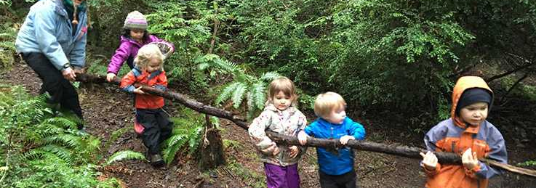
Physical Development Early Years Expectations: Nursery 3
Educational Programme:
Physical activity is vital in children’s all-round development, enabling them to pursue happy, healthy and active lives. Gross and fine motor experiences develop incrementally throughout early childhood, starting with sensory explorations and the development of a child’s strength, co- ordination and positional awareness through tummy time, crawling and play movement with both objects and adults. By creating games and providing opportunities for play both indoors and outdoors, adults can support children to develop their core strength, stability, balance, spatial awareness, co-ordination and agility. Gross motor skills provide the foundation for developing healthy bodies and social and emotional well- being. Fine motor control and precision helps with hand-eye co-ordination which is later linked to early literacy. Repeated and varied opportunities to explore and play with small world activities, puzzles, arts and crafts and the practise of using small tools, with feedback and support from adults, allow children to develop proficiency, control and confidence.
This Photo by Unknown Author is licensed under CC BY-SA

Slide 11
Early Years Expectations: Nursery
Physical Development
Area of Learning : Physical Development
Summer Term N2 (N2+) By the end of the Summer term N2 children should be able to…
• Run with spatial awareness and negotiates space successfully, adjusting speed or direction to avoid obstacles • Balance on one foot or in a squat momentarily, shifting body weight to improve stability • Go up and down stairs, or climb up apparatus, using alternate feet • Start taking part in some group activities which they make up for themselves, or in teams • Increasingly be able to use and remember sequences and patterns of movements which are related to music and rhythm • Manipulate a range of tools and equipment in one hand, e.g. paint brushes, scissors, hairbrushes, toothbrush, scarves or ribbons • Jump up into the air with both feet leaving the floor and can jump forward a small distance • Begin to understand and choose different ways of moving • Change position from standing to squatting and sitting with little effort • Hold equipment/tools consistently in the same hand, e.g., pencil, paint brush, glue spreader. • Hold a pencil consistently in the same hand using a comfortable grip for mark making, name writing, drawing etc. • Have developed finger strength and control in order to be able to manipulate and use tools independently and effectively. • Hold and operate scissors correctly to make snips in paper • Be able to put on own shoes and coat and start to use fastenings • Kick a ball, getting it to go in the desired direction towards a target • Throw a ball, in a desired direction, towards a target or friend • Catch a large, soft ball closing 2 hands on it • Be able to pour water from a larger bottle or jug into another container
Spring Term N2 (N2=) By the end of the Spring term N2 children should be able to…
• Move in different ways on different levels and surfaces being aware of obstacles e.g. other people, bikes (e.g. crawl, jump, climb, shuffle) • Move in response to music, or rhythms played on instruments such as drums or shakers with2 or more movements together. • To be able to stop on a signal or command and stay still • Turn pages in a book being able to stop at the page they want • Walk up stairs and steps using alternate feet • Start to walk down a slope • Use pincer grip to pick up small objects (e.g. shells, pebbles, pompoms) • Use a range of mark making tools to make deliberate marks on paper using the correct pressure • Stand still and upright on a spot, starting to lift one leg • Use large arm movements to create lines and circles pivoting from the shoulder and elbow • Work with other children to pass an object between them e.g. balloon, ball, scarf • Be able to put on own shoes and put on own coat • Move a ball by kicking • Move a ball by rolling or throwing

Slide 12
• Catch a slow moving skills by closing 2 hands on a slow moving objects e.g. balloons, scarves • Use 1 foot to propel themselves on a wheeled toy (e.g. 2 wheeled scooter) with control • Be able to pour water from a small bottle or jug into another container • To use spring loaded scissors to make snips in paper
Autumn Term N2 (N2-) By the end of the Autumn Term N2 children should be able to…
• Walk, run and climb on different levels and surfaces being aware of obstacles e.g. other people, bikes • Move in response to music, or rhythms played on instruments such as drums or shakers with a planned or copied action. • To be able to stop on a signal or command • Turn pages in a book, may be several at once • Walk upstairs facing forwards with both feet onto a single step at a time • Participate in finger and action rhymes, songs and games, copying and imitating the movements • Use smaller paintbrushes, dabbers and chunky mark making tools to make marks on paper, e.g. circles, lines, crosses etc. • Stand still and upright on a spot, being able to move arms • Use large arm movements to wave scarfs, ribbons in circular movements • Work with other children to lift a large object • Be able to put on a pair of wellington boots • Start to move a ball by kicking • Start to move a ball by rolling, dropping or throwing • Start to develop catching skills by closing 2 hands on a slow moving objects e.g. balloons, scarves • Use 1 foot to propel themselves on a wheeled toy (e.g. 3 wheeled scooter) • Be able to pour water from a small bottle or jug • Point to parts of the body when an adult names them • To use spring loaded scissors • Develop fine motor and manipulation skills and finger strength, such as Dough Disco, threading, using tweezers
N1 (N1+) By the end of N1 children should be able to…
• Start to walk, run and climb on different levels and surfaces being aware of obstacles e.g. other people, bikes • Move in response to music, or rhythms played on instruments such as drums or shakers • Turn pages in a board book • Walk upstairs facing forwards holding rail or hand of adult, with both feet onto a single step at a time • Participate in finger and action rhymes, songs and games, trying to copy and imitate the movements • Use paintbrushes and rollers to make marks on paper or a wall outside • Stand still and upright on a spot • Use large arm movements to wave scarfs, ribbons up and down • Be able to put on a pair of wellington boots with support • Use either hands or feet to move a ball • Use 2 feet to propel themselves on a wheeled toy If children are not meeting the demands of these statements at the end of N1, how far behind are they? One term (N1=), two terms (N1-) or working on earlier skills from Development Matters in the Birth to 3 (B, B-, B=, B+). A child who completes 5 terms of nursery, would be seen as on track if recorded as N1= at Easter of N1.

Slide 13
Literacy
Early Years Expectations: Nursery
Educational Programme:
It is crucial for children to develop a life-long love of reading. Reading
consists of two dimensions: language comprehension and word reading. Language comprehension (necessary for both reading and writing) starts from birth. It only develops when adults talk with children about the world around them and the books (stories and non-fiction) they read with them, and enjoy rhymes, poems and songs together.
Skilled word reading, taught later, involves both the speedy working out of the pronunciation of unfamiliar printed words (decoding) and the speedy recognition of familiar printed words. Writing involves transcription (spelling and handwriting) and composition (articulating ideas and structuring them in speech, before writing).

Slide 14
Early Years Expectations: Nursery
Literacy
Area of Learning : Literacy
Summer Term N2 (N2+) By the end of the Summer term N2 children should be able to..
• Ascribe meanings to signs, symbols and words that they see in different places, including those they make themselves • Talk about events and main characters in stories • Suggest what happens next in a story/how it might end • Retell a very familiar story – using at least three sentences – beginning, middle and end with picture prompts. • Look at and enjoy books independently, use illustrations to gain an understanding of story events • Distinguish between illustrations and print • Know that print carries meaning and, in English, is read from left to right and top to bottom • Be interested in words that rhyme by finishing a rhyming string, choosing a rhyming pair or beginning to offer up their own rhyming words. • Through playing language games and reading stories, children are beginning to pick out alliterative words, e.g. matching from a choice of three • Independently clap the syllables in words • Hear and says the initial sound in words e.g. can tell you the initial sound in their name, can play I spy with a few choices • Engage in activities involving segmenting and blending spoken words orally • Include mark making and early writing in their play, using more letter like shapes/letters they are familiar with. • Imitate adults’ writing by making continuous lines of shapes and symbols (early writing) from left to right • Make an attempt at writing their own name, or other names and words, using combinations of lines, circles and curves, or letter-type shapes • Independently recognise their name in different contexts • Be able to sing a selection of simple nursery rhyme all the way through e.g. Twinkle, twinkle, Humpty Dumpty, Baa, Baa Black sheep, Incy Wincy Spider. Paying attention to the rhythm/rhyme e.g. pausing in appropriate places. (3-5) • Enjoy and engage in a variety of stories, poems, songs and rhymes • Enjoy listening to longer stories and can remember much of what happens.
Spring Term N2 (N2=) By the end of the Spring term N2 children should be able to…
• Listen and engage with an unknown short story in a small group , e.g. commenting on the illustration • Listen to familiar stories with increasing attention and engagement • Know that there is a beginning and an end to a story. • Attempt to recall elements of familiar stories and will tell own stories based on stories they have heard and personal experiences. • Say what they like or dislike about a story or character, linked to their own experience of feelings. • Listen to and join in with a wider range of texts, when reading one-to-one and in small groups • Join in with repeated refrains and anticipate key events and phrases in rhymes and stories • Handle books carefully and the correct way up with growing competence • Understands that an author writes the words/story, an illustrator does the pictures and what a character is including main one. • Begin to develop phonological awareness through exposure to alliteration, rhyming words and stories, syllable demarcation, e.g. clapping syllables in new vocabulary ‘ice-cream’ • Begin to include mark making in their play, e.g. making signs and lists ‘I’m writing a shopping list’ • Independently make pre-writing shapes and symbols, e.g. circles, crosses, lines etc

Slide 15
• Recognise their own name from a selection and letters from their own name in other contexts, e.g. ‘That’s in my name’ • Can distinguish between picture and writing in their own mark making, e.g. circle for face but squiggle or zig zag for ‘words’ • Begin to copy letters from their own name and words they are interested in writing, e.g. mum, dog etc Copy syllable clapping for their own name • Know information can be relayed through signs and symbols in various forms (e.g., printed materials, digital screens and environmental/classroom print, shop signs) • Drawing is taking recognisable form, e.g. circle for face, eyes, nose, mouth etc. • When sharing a book, know that the text is what tells us what to say.
Autumn Term N2 (N2-) By the end of the Autumn Term N2 children should be able to…
• Repeat and use actions, words or phrases from familiar stories • Use learned vocabulary from familiar stories in their own play, e.g. ‘I’ll huff and I’ll puff and I’ll blow your house down’ • Fill in the missing word or phrase in a known rhyme, story or game, e.g., Humpty Dumpty sat on a ... • Have some favourite stories, rhymes, songs, poems or jingles • When sharing a book can distinguish between the print and the illustration. • Understand the words ‘cover’ and ‘pages’ in relation to books. • Be able to recognise, discover and talk about the difference between environmental and instrumental sounds in their environment. • Engage in purposeful mark making and assign meaning to their marks, e.g. ‘this is a dog’ • Beginning to choose a dominant hand for mark making • Beginning to copy pre-writing shapes, e.g. circles, lines, crosses etc. • Take part in activities that support fine motor and manipulation skills and finger strength, such as Dough Disco, using tweezers, threading
By the end of N1 (N1+) By the end of N1 children should be able to…
• Show recognition of familiar stories and rhymes, .e.g twinkle twinkle, • Enjoy rhythmic and musical activities with percussion instruments, actions rhymes and songs, clapping and joining in with actions of familiar songs and nursery rhymes • Listens to rhymes and a short story on a 1:1 / small group basis and may have favourites • Voluntarily picks up a book and mimics reading by turning the pages. • Engage in mark making, showing awareness that they’re making marks, e.g. changing coloured pen or pencil, painting with the brushes outside, using chalks. • Learn Nursery Rhymes and simple songs repeat and sing daily. If children are not meeting the demands of these statements at the end of N1, how far behind are they? One term (N1=), two terms (N1-) or working on earlier skills from Development Matters in the Birth to 3 (B, B-, B=, B+). A child who completes 5 terms of nursery, would be seen as on track if recorded as N1= at Easter of N1.

Slide 16
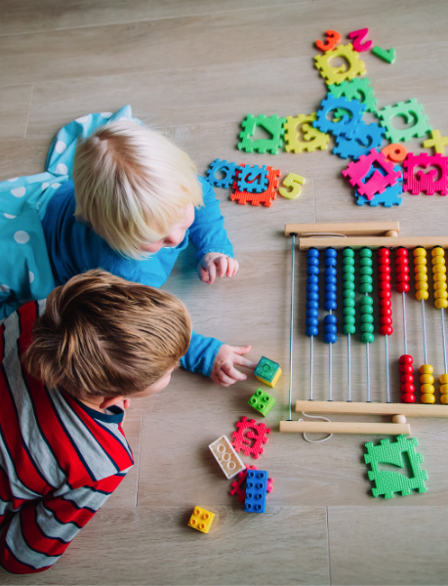
Mathematics
Early Years Expectations: Nursery
Educational Programme:
Developing a strong grounding in number is essential so that all children develop the necessary building blocks to excel mathematically. Children should be able to count confidently, develop a deep understanding of the numbers to 10, the relationships between them and the patterns within those numbers. By providing frequent and varied opportunities to build and apply this understanding - such as using manipulatives, including small pebbles and tens frames for organising counting - children will develop a secure base of knowledge and vocabulary from which mastery of mathematics is built. In addition, it is important that the curriculum includes rich opportunities for children to develop their spatial reasoning skills across all areas of mathematics including shape, space and measures. It is important that children develop positive attitudes and interests in mathematics, look for patterns and relationships, spot connections, ‘have a go’, talk to adults and peers about what they notice and not be afraid to make mistakes.

Slide 17
Early Years Expectations: Nursery
Mathematics (bold statements are the key focus for the term)
Area of Learning : Mathematics
Summer Term N2 (N2+) By the end of the Summer term N2 children should be able to…
• Subitise up to three objects (fast recognition without counting) • Recite numbers past 5 by rote and with visual aid e.g number line with picture to match each numeral • Recognise that each counting number is one more than the one before – visual aid including the idea of a staircase in ones • Count back from 5 to 0 by rote • Hold fingers up correctly for each number to 5 when counting orally • Count on in 1s from any number up to 5 – visual aid and fingers • Be able to say the number before and after a given number to 5 – visual aids • Chant rhymes and songs involving numbers to 5 and beyond, e.g., 1,2,3,4,5 once I caught a fish alive • Recognise numerals 0-5 • Counting one-to-one correspondence to 5 – how many? (1:1 principle) • Counting one-to-one correspondence to 5 – give me? (1:1 principle) • Know that the order in which objects are counted doesn’t affect the total e.g left to right or right to left … (order irrelevance principle) • When counting objects, Say one number for each item in order e.g 1,2,3 … (stable order principle) • Know that the last number reached when counting a small set tells you how many there are (cardinal principle) • Know that anything can be counted to 5, for example drum beats, claps, pictures in a book, large objects and tiny… (Abstraction principle) • Link numerals and amounts to up to 5 by matching objects to the number • Experience the language of zero meaning nothing through play and every day practical activities, e.g., there are no oranges left in the bowl • Begin to display an understanding of the composition of numbers to 5, for example 1 + 2, 0 +3, 1+1+1 with objects • Begin to add and subtract using practical resources to 3, with practitioners modelling the language e.g., add, altogether, total, is the same as, subtract, take away, how many left, more and less, bigger and smaller • Solve real world maths problems with numbers up to 5 – e.g., there are 4 children and 3 chairs – how many more chairs do we need? • Begin to understand ordinal numbers in real-life situations: first, second … • Order and compare a set of numbers 0-3, and explore the language more and fewer with objects and quantities • Make pictures and patterns (e.g., in sand or paint) using key mathematical resources, including: numicon, counters, 10-frames and cubes • Say some common shape names, e.g., circle, square, rectangle, triangle • Talk about and explore 2D and 3D shapes using informal language – sides, corners, straight, flat, round • Enjoy partitioning and combing shapes to make new shapes, e.g., circle, square, rectangle, triangle, heart, star, diamond • Sort shapes by a given criteria, for example circles here, straight sides in here – use a variety of sized shapes • Understands and uses the language of position, e.g., on, inside, next to, under, over, in front, behind through play, for example a doll’s house or garage • Make models in the block area and respond to practitioners using the vocabulary can you make it taller? Shorter? Longer? • In meaningful contexts, find the longer or shorter, heavier or lighter and more/less full of two items • Recognise and discuss patterns on clothes, in nature and in the environment, e.g., stripes, spots, checks, etc

Slide 18
• Notice and correct an error in a repeating pattern – show AB patterns correct and incorrect • Recall a sequence of events in everyday life and stories • Show an awareness of a sense of time, e.g., morning, afternoon, evening and night-time • Begin to sing days of the week – begin to understand yesterday and tomorrow
Spring Term N2 (N2=) By the end of the Spring term N2 children should be able to…
• In preparation for subitising, play games with a dice and dominos • Recite numbers up to 5 and beyond with support - Adult to model counting at all times in the session, for example lining up, giving out fruit… • Begins to point, touch or move each item, saying one number name for each item - 1, 2, 3 (stable order principle) whilst playing • Begin to recognise numbers which are familiar to themselves, e.g., their age… Have visual number lines on display and begin to refer to them. How old are you 3? 4? Can you find the number 3? … • Chant rhymes and songs involving numbers, e.g., five speckled frogs • Show fingers for numbers to 5 with support whilst counting or singing number songs • Becoming familiar and aware of (through play) the key mathematical resources, including: numicon, counters, tens frames and cubes Begin to display an understanding of composition of numbers up to 3 Begin to recognise numbers 4 & 5 • Compare two small groups of objects, saying when there are the same number of objects in each group, e.g., ‘You’ve got two, I’ve got two. Same!’ • Play with and begin to name some common shapes, e.g., name circle, square • Respond to both informal and common shape names, e.g., find something pointy, twisty, wiggly, bumpy, heart, star, flower, straight, wavy, bent • Classify and sort shapes by a given criteria, for example big circles and small circles • Classify and sort classroom objects according to a given criteria, e.g., put the books in the book area, cars in the basket … • Begin to understand and respond to the language of position, e.g., on, inside, next to, under, over, in front, behind - playing with practitioner and following instructions • Show an awareness of what’s happening now and what is happening next through every day activities, getting dressed – first socks then shoes • Create and extend AB patterns, e.g., stick, leaf, stick… red, blue, red … movement patterns clap, stamp …
Autumn Term N2 (N2-) By the end of the Autumn Term N2 children should be able to…
• Shows an interest in numbers through games and playful activities • Begin to say the number names, some of which are in the right order (rote counting) • Begin to count on their fingers to 3 Begin to recognise numbers 1,2,3 • Compare amounts saying which has more or the same • Listen and enjoy number songs and rhymes – join in with some parts e.g finish the line of song, fill in missing parts Recognise and discuss patterns on clothes, in nature and in the environment, e.g., stripes, spots, checks, etc • Explore differences in size, length, weight and capacity – which one is longest? Heaviest? Full? Empty? • Predict, move and rotate objects to fit the space or create the shape they would like (inset puzzles and simple jigsaws) • Begin to understand some talk about immediate past and future – before, now and next • Join in with simple patters in sounds, objects, games, stories, dance and movements, predicting what comes next
N1 (N1+) By the end of the Summer Term N1 children should be able to…
• Listen to, enjoy and begin to sing counting songs - such as ’1 little finger, 1 potato, 5 little ducks and ‘1, 2, 3, 4, 5, Once I Caught a Fish Alive’ – as a means to develop early counting • Join in with listening to books and stories involving numbers, for example My Three Book, and join in with naming numbers in the book • Talk about numbers around them, for example from door numbers, and begin to know that numbers are part of everyday life • Say some counting words, engaging in counting-like behaviour, making sounds and pointing or saying some numbers – possibly in sequence

Slide 19
• Begin to learn numerals by having fun exploring a range of resources including: foam numbers, numicon pieces, sand, water, chalk, etc
• Begin to learn about shapes by having fun exploring a range of resources including: 2d shapes, 3d shapes and blocks to create their own simple structures and arrangements
• Begin to explore capacity by selecting, filling and emptying containers
• Begin to compare and recognise changes in number of things, using words like more, lots of, same
• Show interest in what happens next using the pattern of everyday routines, including times of the day such as, meal times or home time
If children are not meeting the demands of these statements at the end of N1, how far behind are they? One term (N1=), two terms (N1-) or working on earlier skills from Development Matters in the Birth to 3 (B, B-, B=, B+). A child who completes 5 terms of nursery, would be seen as on track if recorded as N1= at Easter of N1.

Slide 20
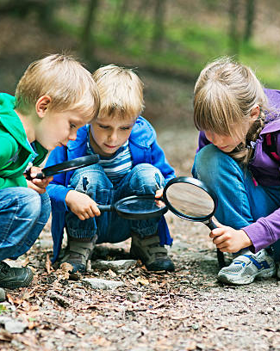
Understanding the World
Early Years Expectations: Nursery
Educational Programme:
Understanding the world involves guiding children to make sense of their physical world and their community. The frequency and range of children’s personal experiences increases their knowledge and sense of the world around them – from visiting parks, libraries and museums to meeting important members of society such as police officers, nurses and firefighters. In addition, listening to a broad selection of stories, non-fiction, rhymes and poems will foster their understanding of our culturally, socially, technologically and ecologically diverse world. As well as building important knowledge, this extends their familiarity with words that support understanding across domains. Enriching and widening children’s vocabulary will support later reading comprehension.

Slide 21
Early Years Expectations: Nursery
Understanding the World
Area of Learning : Understanding the World
Summer Term N2 (N2+) By the end of the Summer term N2 children should be able to…
• Use all their senses in hands-on exploration of natural materials • Explore collections of materials with similar and/or different properties • Talk about what they see, using a wide range of vocabulary • Begin to make sense of their own life story and family’s history • Ask questions about people outside their immediate family using images / props, e.g. ‘Why does the king wear a crown?’ • Know that there are different jobs and occupations and talk about some common ones (link to community and area) • Explore how known and new objects work, knowing they may be electrical, manual etc • Understand and begin to name the four seasons and typical weather, clothing and events • Understand the life cycle of an animal - they are born, they grow – using stories • Use images, stories and real experiences to develop an understanding of animal mothers and babies, e.g. Sheep / Lamb • Begin to understand the need to respect and care for the natural environment and all living things • Talk about how different forces impact on ourselves / objects, e.g. sails of a ship • Talk about different materials using a wider range of vocabulary • Know that some materials change and give examples e.g. ice, baking • Continue developing positive attitudes about the differences between people • Know that there are countries beyond ours and that things are the same and different in these, in comparison to ours (use children’s experiences, photos and books) • Show some awareness of the similarities and differences between themselves and others in more detailed ways e.g. hair colour, skin colour, height, glasses, siblings family members
Spring Term N2 (N2=) By the end of the Spring term N2 children should be able to…
• Show interest in the lives of people who are familiar to them, including people seen in shops, hairdressers • Remember and talk about significant events in their own experience • Understand past and present through their life – baby, child, adult • In pretend play, imitate everyday actions and events from own family and cultural background, e.g., making and drinking tea, going to the barbers, being a cat, dog or bird • Understand the current season and typical weather, clothing and events • Enjoy playing with small world reconstructions, building on first-hand experiences, e.g., visiting farms, garages, train tracks, walking by river or lake • Learn the vocabulary associated with specific interest areas • Talk about and notice the changes in materials, e.g., ice, snow, mud, • Use pipes, funnels and other tools to carry/ transport water from one place to another • Play with water to investigate ‘low technology’, such as washing and cleaning • Show an interest in technological toys with knobs, wind-up or pulleys, real objects, such as cameras, and touchscreen devices, and tablets • Explore and talk about different forces e.g., push, pull, things you feel, wind, rain, weather Plant seeds, care for them and know they will grow into a plant. Relate this to life cycle of a plant • To know that trees, flowers and grass are plants and are living and grow

Slide 22
• To know that animals need things to live, just as humans do • To know we can help to look after our immediate environment e.g. tidy up, put rubbish in the bin
Autumn Term N2 (N2-) By the end of the Autumn Term N2 children should be able to…
• Be interested in photographs of themselves, their family and objects • Be interested in the different things that people do e.g. occupations, hobbies, activities indoors and outdoors • Explore unfamiliar objects by linking together different approaches: shaking, hitting, looking, feeling, tasting, pulling, turning and poking • Use toys with buttons, flaps and simple mechanisms and begin to learn how to operate them • Learn new vocabulary associated with specific interest areas • Talk about people outside their immediate family using images / props, e.g. the king • Match objects that pair together e.g. toothbrush and toothpaste • Use a pull-back toy correctly, turn a sound feature on and off • Learn the vocabulary associated with specific interest areas • Explore materials, e.g., mud, puddles, sand, grass and feathers • Start to group living things e.g. plants, animals, people • Understand the current season and typical weather, clothing and events • To start to talk about own immediate environment • To move an object by pushing, pulling etc • To know that objects can move within the environment (wind, water etc) • To sort different materials Notice changes in materials chocolate and jelly. • To talk about similarities and differences within a group e.g. what did you have for breakfast, what do you watch on TV? • Remember where objects belong • Show awareness of personal features when asked e.g. stand up if you are wearing a blue jumper, recognising when others have stood up, this is how they are similar.
N1 (N1+) By the end of N1 children should be able to…
• Be interested in photographs of themselves and their family • Explore familiar objects by linking together different approaches: shaking, hitting, looking, feeling, tasting, mouthing, pulling, turning and poking • Show interest in toys with buttons, flaps and simple mechanisms and begin to learn how to operate them • Use some words related to child’s own interests • Understand different types of weather and how that affects our clothing • Show curiosity about people outside their immediate family • Match parts of known objects that fit together, e.g. lids with its matching part • Anticipate repeated sounds, sights and actions, e.g., when an adult demonstrates an action toy several times • Show curiosity about living things in books and the outdoors • Explore own immediate environment • To know that you can move an object • To explore different surfaces (e.g. bumpy, smooth, hot, cold) • To identify / talk about objects that are the same, e.g. matching an inset puzzle If children are not meeting the demands of these statements at the end of N1, how far behind are they? One term (N1=), two terms (N1-) or working on earlier skills from Development Matters in the Birth to 3 (B, B-, B=, B+). A child who completes 5 terms of nursery, would be seen as on track if recorded as N1= at Easter of N1.

Slide 23
Expressive Arts and Design
Early Years Expectations: Nursery
Educational Programme:
The development of children’s artistic and cultural awareness supports their imagination and creativity. It is important that children have regular opportunities to engage with the arts, enabling them to explore and play with a wide range of media and materials. The quality and variety of what children see, hear and participate in is crucial for developing their understanding, self-expression, vocabulary and ability to communicate through the arts. The frequency, repetition and depth of their experiences are fundamental to their progress in interpreting and appreciating what they hear, respond to and observe.

Slide 24
Early Years Expectations: Nursery
Expressive Arts and Design
Area of Learning : Expressive Arts and Design
Summer Term N2 (N2+) By the end of the Summer term N2 children should be able to
• Listen to and respond to music and the patterns in music, matching the sound of a musical instrument, copying a sound pattern • Moves creatively in response to music • Sing a simple nursery rhyme or song all the way through e.g. Twinkle, Twinkle, Humpty Dumpty, Baa, Baa Black Sheep • Draws an identifiable picture of a person and basic animal • Explores colour mixing with a range of media, e.g. tissue paper, food colouring/water, light boxes, • Hold equipment/tools consistently in the same hand, e.g., pencil, paint brush, glue spreader. • Hold a pencil consistently in the same hand using a comfortable grip (tripod where possible) for mark making, name writing, drawing etc. • Develop finger strength and control in order to manipulate and use tools independently and effectively e.g. hold and operate scissors correctly to make snips in paper • Use a range of resources to build with a purpose or meaning e.g. junk modelling, construction kits, loose parts, wooden blocks • Engage in imaginative play based on own ideas or first-hand or peer experiences • Begin to develop complex stories using small world equipment like animal sets, dolls and dolls houses • Use available resources to create props or creates imaginary ones to support play • Play with one or more other children, extending and elaborating play ideas • Use drawing to represent ideas like movement or loud noises, such as movement / art to music • Show different emotions in their drawing / paintings like happiness, sadness, fear e.g. on people’s faces
Spring Term N2 (N2=) By the end of the Spring term N2 children should be able to…
• Use sounds to express experiences, expertise, ideas and feelings • Creates some movements in response to music, stories and ideas • Create their own songs or improvise a song around one they know • Starting to draw a recognisable picture, e.g. circle for face, eyes, nose, mouth etc… • Sing parts of a range of familiar songs, e.g., pop songs, songs from TV programmes, rhymes, songs from home • Begin to add purpose and meaning to their building with resources e.g. junk modelling, construction kits • Takes part in pretend play using an object to represent something else even though they are not similar • Play alongside other children who are engaged in the same theme
Autumn Term N2 (N2-) By the end of the Autumn Term N2 children should be able to…
• Knows how to use sounds (voice, body and instruments) e.g. following instructions from others, responding to listening to music • Joins in with moving, dancing and ring games • Tap out simple repeated rhythm e.g. clapping, tapping knees, using an instrument • Join in with familiar songs and rhymes • Continue to explore colour and how colours can be changed e.g. combining colours

Slide 25
• Develop an understanding of marks to represent objects or images e.g. using pencil lines to enclose a space whilst drawing, making marks in the sand • Use various construction materials, e.g., joining pieces, stacking vertically and horizontally, balancing, making enclosures and creating spaces • Use tools for a purpose e.g. glue spreader • Takes part in simple pretend play using an object to represent something else
N1 (N1+) By the end of N1 children should be able to…
• Show an interest in the way sound makers and instruments sound and experiments with ways of playing them, e.g. loud/quiet, fast/slow • Listens to music for short periods of time and can describe the sounds they hear e.g. scary music • Carries out actions in response to rhymes and songs • Learn Nursery Rhymes and simple songs repeat and sing daily. • Uses a range of media to make marks and begin to give meaning to those marks, e.g. this ‘splodge’ is my dog • Enjoy and respond to playing with colour in a variety of ways • Explores 3D materials to experiment and/or create simple structures e.g. construction kits, junk modelling • Manipulates 2D shapes to explore materials • Begin to make believe by pretending, using sounds, movements, words, objects e.g. small world resources, role-play If children are not meeting the demands of these statements at the end of N1, how far behind are they? One term (N1=), two terms (N1-) or working on earlier skills from Development Matters in the Birth to 3 (B, B-, B=, B+). A child who completes 5 terms of nursery, would be seen as on track if recorded as N1= at Easter of N1.

Slide 26
Assessment and Tracking
Nursery Tracking Support
Our curriculum is the progression model. If the curriculum is well planned and progressive – and children learn the planned curriculum, then they are making progress – they know and remember more. As such, our tracking for children across 9early years is simple… are they learning the planned curriculum in each of the 7 areas of learning? Are they ‘best fitting’ within the correct term’s content, in relation to what they can do and remember? And if not, at what point are they up to and what do they need to learn next?
A child who is learning the planned curriculum as expected would simply follow:
By Easter One | N1= | A child who has kept pace with the planned curriculum by the end of the Nursery 2 year , would best fit within the 3-4 Years Development Matters statements – as used to support the formulation of this document.0
By Summer One | N1+
By Christmas | N2-
By Easter | N2=
By End Of Year | N2+
Using this methodology, a child who enters nursery with typical levels of knowledge and skill expected for their age would be baselined signifying they are best fitting within the content of them prior to starting the setting. E.g. a ‘typical’ child joining an N2 class in September, would be baselined as N1+ (on track at the end of the previous term). Children who are not displaying age appropriate skills can be assessed at any point on the scale below. In essence, each ‘grade’ represents a term’s worth of curriculum content. The OFSTED 6 expectation is that most children who enter below, but not significantly below, should catch up with good teaching.

Slide 27
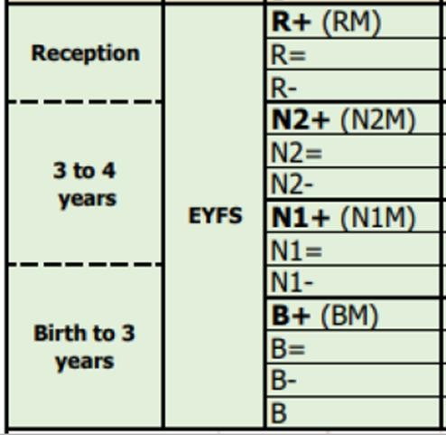
These examples are illustrative of the journey that some children may make across their time in nursery. Based on the needs of the child, some children may make more progress, others less. For example, some children could make rapid progress from lower starting points from those suggested above, and achieve the end of year target. Assessment information however, should be useful and used effectively to plan the next steps of the child.

