Slide 1
Lockwood Primary School
Year 4 Times Tables Check

Slide 2
Why Are Times Tables Being Checked?
The DfE in England want to measure improvements.
To check if year 4 pupils can quickly recall their multiplication tables.
There is no ‘pass’ threshold.

Slide 3
Who? - All eligible year 4 pupils
When? - 3 week window in June
- No set day
- Children taking the check at the same time

Slide 4
How?
Online – input via
keyboard or by
pressing digits using
a mouse

Slide 5
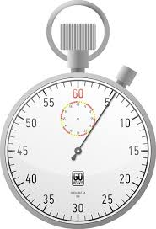
How Will They Be Carried Out?
less than 5 minutes per pupil.
6 seconds from the time the question appears to input their answer.
25 questions with a 3 second pause in-between questions.

Slide 6
Special Arrangements
Children with additional needs, who have similar provision in their day-to-day learning at school, may be allotted specific arrangements, including:
Removing on-screen number pad;
An adult to input answers;
Question reader;
Audible time alert
Colour contrast;
Font size adjustment;
‘Next’ button (alternative to 3-second pause);

Slide 7
The Questions
randomly assigned
questions may be repeated
only multiplication statements in the check (not related division facts)
results not shown on screen

Slide 8
The Check
questions from the 3, 4, 5, 6, 7, 8, 9, 11 and 12 tables
no questions from the 1 times table (i. e. 1 x 8 or 8 x 1)
6, 7, 8, 9 and 12 times tables are more likely to be asked
maximum of 7 questions from the 2, 5 and 10 times tables
reversal of questions will not feature in the same check

Slide 9
Questions More Likely To Appear
The following 11 multiplication questions are more likely to be asked:
6 x 6, 6 x 7, 6 x 8, 6 x 9, 6 x 12
7 x 8, 7 x 9, 7 x 12
8 x 9, 8 x 12
12 x 12

Slide 10
Before The Check
Children can practise beforehand.
There will be a ‘try it out’ area the children can use to become familiar with the timings and layout of the check.

Slide 11
In-school Teaching/Learning
Counting and looking for patterns
Repeated addition
Multiplication is commutative
Number families
Use of different representations
Concrete manipulatives such as counters or multilink cubes
Pictorial representations such as arrays

Slide 12
Counting and looking for patterns
Counting in 2s
2, 4, 6, 8, 10…
Ensure children have a strong understanding of counting in groups first.
When children are secure with counting, they can then look for patterns.

Slide 13
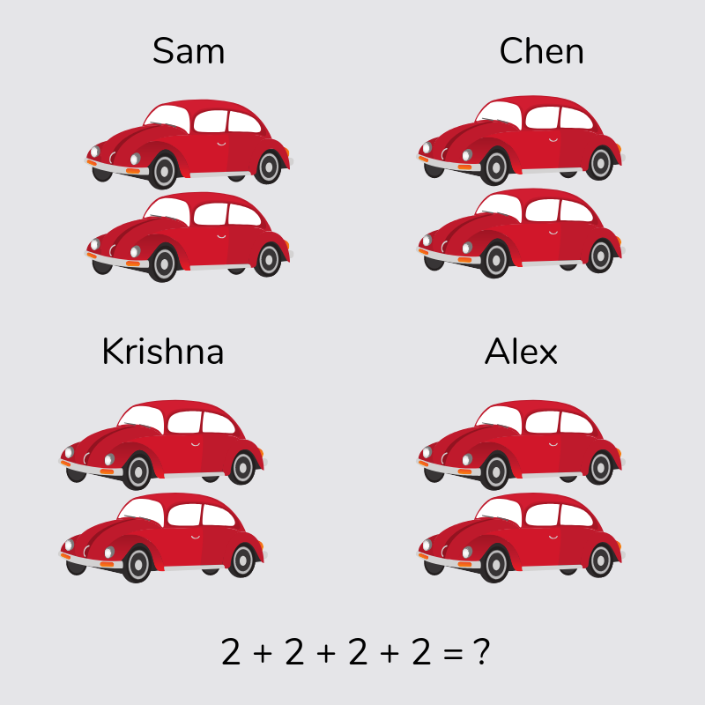
Repeated addition
Knowing that 2 x 4 is the same as 2 + 2 + 2 + 2
Pictorial representations

Slide 14
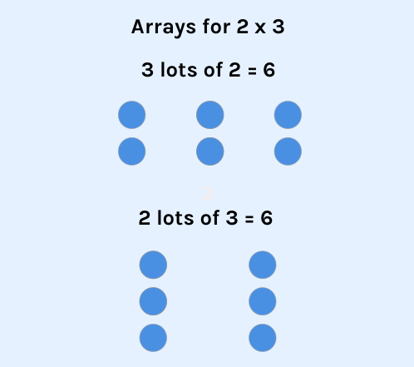
Multiplication is commutative
3 x 2 is the same as 2 x 3.
Children need to understand that multiplication can be completed in any order to produce the same answer.

Slide 15
Multiplication Is The Inverse Of Division
20 ÷ 5 = 4 can be worked out because 5 x 4 = 20.
Using pictorial representations
(such as arrays) is useful
here for children to see the
link between multiplication
and division.

Slide 16
Number Families
4 x 5 = 20, 5 x 4 = 20, 20 ÷ 5 = 4, 20 ÷ 4 = 5
Due to their commutative understanding, children should also be able to see whole number families. For many children this needs to be pointed out and discussed.
20
4
5

Slide 17
Using Known Facts
7 x 12 = ?
I know 7 x 11 = 77
Therefore, 77 + 7 = 84
By using known facts from ‘easier’ times tables, children should be able to find answers with increasing speed.

Slide 18
How You Can Support Your Child
Firstly, a positive attitude goes a long way – so as much encouragement and support as possible (but we don’t need to tell you that)!
Make times tables fun;
Climb stairs counting in multiples
Play verbal times tables games
Listen to and learn times tables songs
Take it in turns to say different times
tables in funny voices
Play online maths games especially TT Rockstars

Slide 19
If you have any worries, come and see us
(try not to worry your child)
Encourage your child to talk to you, their teacher, or
another adult they trust, if they show persisting
anxieties about the check.
Remember that a small amount of anxiety is normal and not harmful.

Slide 20
Remember
The check will focus on what they know about times tables
It won’t reflect their understanding of wider mathematical topics.
The check is only 5 minutes long
For most children, the check will last for a maximum of 5 minutes. When they have finished, they will not need to repeat the check, regardless of their final score.

