Slide 1
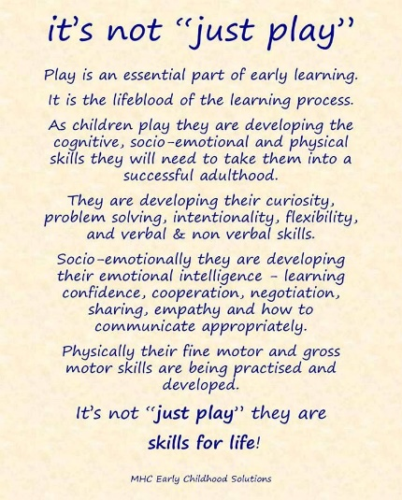
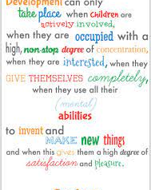
Lockwood Primary School EYFS: Nursery
At Lockwood, we aim to support children to become independent and collaborative leaners. We will provide a broad and balanced curriculum that caters for all children’s needs and respects children’s interests and stages of development.
At Lockwood, children within EYFS are provided with a stimulating learning environment which encourages independent learning through play – a fundamental part of early learning. (Continuous Provision – this is enhanced as necessary.)

Slide 2
Introduction
“Every child deserves the best possible start in life and support to fulfil their potential. A child’s experience in the early years has a major impact on their future life chances. A secure, safe and happy childhood is important in its own right and it provides the foundation for children to make the most of their abilities and talents as they grow up”
Early Years Foundation Stage Profile – Department for Children, Schools and Families 2012.
The Early Years Foundation Stage (EYFS) applies to children from birth to the end of reception year. At Lockwood Primary School, children are admitted into nursery in the term that they are three (when possible) and into reception in the September following their fourth birthday.
Early childhood is the foundation on which children build the rest of their lives. At Lockwood, we greatly value the importance that the EYFS plays in laying secure foundations for future learning and development.
However, we also believe that early childhood is valid in itself as part of life. It is important to view the EYFS as preparation for life and not simply preparation for the next stage of education.
When thinking about Early Years we need to have these four principles at the forefront of what we do
Every child is a unique child, who is constantly learning and can be resilient, capable, confident and self-assured
Children learn to be strong and independent through positive relationships
Children learn and develop well in enabling environments, in which their experiences respond to their individual needs and there is a strong partnership between practitioners and parents and/or carers.
Children develop and learn in different ways and at different rates.
We fully embed the three Characteristics of Effective Teaching and Learning -
playing and exploring - children investigate and experience things, and ‘have a go’
active learning - children concentrate, keep on trying if they encounter difficulties, and enjoy achievements
creating and thinking critically - children have and develop their own ideas, make links between ideas, and develop strategies for doing things.

Slide 3
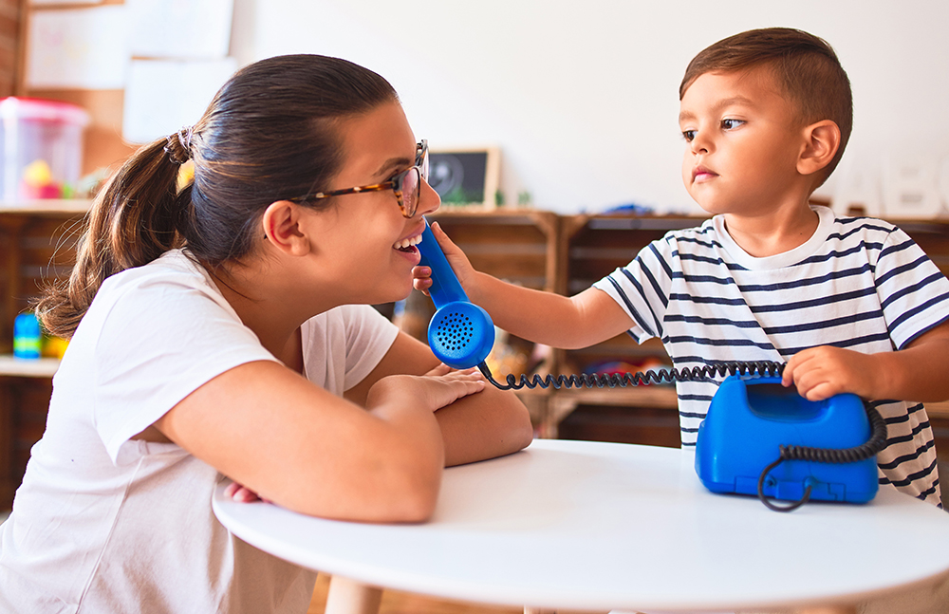
Communication and Language
Early Years Expectations: Nursery
Educational Programme:
The development of children’s spoken language underpins all seven areas of learning and development. Children’s back-and-forth interactions from an early age form the foundations for language and cognitive development. The number and quality of the conversations they have with adults and peers throughout the day in a language-rich environment is crucial. By commenting on what children are interested in or doing, and echoing back what they say with new vocabulary added, practitioners will build children's language effectively. Reading frequently to children, and engaging them actively in stories, non-fiction, rhymes and poems, and then providing them with extensive opportunities to use and embed new words in a range of contexts, will give children the opportunity to thrive. Through conversation, story-telling and role play, where children share their ideas with support and modelling from their teacher, and sensitive questioning that invites them to elaborate, children become comfortable using a rich range of vocabulary and language structures.

Slide 4
Early Years Expectations: Nursery
Communication and Language
Area of Learning : Communication and Language
Summer Term N2 (N2+) By the end of the Summer term N2 children should be able to…
• Enjoy listening to longer stories and can remember much of what happens • Be able to sing a selection of simple nursery rhymes all the way through e.g., Twinkle, Twinkle Little Star, Humpty Dumpty, Baa, Baa Black Sheep, Incy Wincy Spider • Foster a love of a variety of stories, poems, songs and rhymes • Attend to, listen and respond appropriately in a range of situations (one to one, small group or whole class) with adults and/or their peers. • To be able to understand and follow adult directions in a range of contexts, e.g. ‘Give me your attention please. It’s time to stop and tidy up’ • Use a wider range of vocabulary linked to curriculum and experiences • Show an ability to follow instructions, concentrate, think and extend ideas • Show an understanding of prepositions, such as under, on top, behind by carrying out an action or selecting correct picture • Understand ‘who’, ‘how’ and ‘why’ questions, such as ‘Why do you think the caterpillar got so fat?’, and give an explanation • Develop their pronunciation but may have problems saying: - sounds: r,j,th,ch and sh • Speak clearly in a sentence using 4-6 words consistently • Be able to use language in recalling past experiences • Use talk to explain what is happening and organise themselves in their play, e.g. ‘Let’s go on a bus…you be the driver…I’ll sit here’ • Begin to use a range of tenses (e.g. play, playing, will play, played) • Develop their communication, recognising some age-appropriate errors in language (e.g. swimmed, runned) and will absorb and use language they hear around them in their community and culture • Be able to express a point of view and to debate when they disagree with an adult / friend, using words as well as actions • Start a conversation with an adult / friend and continue it for many turns • Begin to use some expression in their conversations • Begin to recognise ‘waiting your turn’ in a conversation when someone else is speaking • Understand a question or instruction that has 2 parts, such as ‘Get your coat and wait at the door’.
Spring Term N2 (N2=) By the end of the Spring term N2 children should be able to…
• Listen and engage with an unknown short story in a small group , e.g. commenting on the illustration • Join in with repeated refrains and anticipates key events and phrases in rhymes and stories • Focus attention (in self chosen activities) – can still listen or do, but can change their own focus of attention • Understand the use of, and vocabulary related to, tools / objects, e.g. ‘Which one do we cut with?’ or ‘what would help us to move this sand?’ • Respond to instructions with more elements, e.g., ‘Give the big ball to me; collect up all the blocks and put them in the box’. • Use language to share feelings, experiences and thoughts • Begin to hold a conversation but might jump from topic to topic • Learn new words quickly and begin to be able to use them in communicating (links to topics, e.g., flower, leaf, petal)

Slide 5
• Begin to use a variety of questions e.g. what, where, can • Begin to use longer sentences, e.g. ‘I hurt my finger…’ (and what on) • Retell a simple past event in correct order e.g. ‘went down slide, hurt my finger’
Autumn Term N2 (N2-) By the end of the Autumn Term N2 children should be able to…
• Listen to familiar stories with increasing attention and engagement • to others in one-to-one or small groups, when conversation interests them • Single channelled attention; shift to a different task if their attention is fully obtained – using a child’s name helps them to focus • Join in with simple repeated refrains in rhymes, songs and stories • Understand who & what in simple questions, e.g. ‘Who’s that?’ ‘Who can…?’ ‘What’s that?’ • Name everyday objects, e.g., scissors, ball, hat, coat, book • Respond to instructions with more elements, e.g., ‘Give the big ball to Tom’ • Begin to ask simple questions e.g ‘Can I have a turn?’, ‘Where’s my picture?’ • Begin to talk about people and things that are not present, e.g. ‘my nana has a dog’
END OF N1 CHECKPOINTS (N1+) By the end of N1 children should be able to…
• Begin to talk / share / sing in a range of familiar situations or group • Listen to and enjoy rhythmic patterns in rhymes and stories, trying to join in with actions or vocalisations • Listen with interest and respond to alliterative phrases/voice sounds within stories, e.g ‘Boo!’, ‘Wheeeeeee!’ • Learn nursery rhymes and simple songs. Repeat and sing daily. • Understand simple sentences e.g. ‘Sam, throw the ball’ • Identify action words by following simple instructions, e.g., ‘Can you jump like a frog?’ • Developing understanding of simple concepts, e.g. fast / slow, hot / cold • To listen and respond to an adult instruction, with supportive gesture, e.g. ‘stop’, ‘hold my hand’, ’come to the carpet’ • Use different types of everyday words (nouns, verbs and adjectives, e.g. banana, go, sleep, soft & colours) • Pay attention to own choice of activity for a more sustained period of time, to complete a chosen task • Recognise and respond to many familiar sounds, e.g., turning to a knock on the door, looking at or going to the door • Show interest in playing with sounds, songs and rhymes • Select familiar objects by name and will go and find objects when asked, or identify objects from a group • Copy actions from words, e.g., stop, clapping, jumping • Understand ‘where’ in simple questions, e.g., ‘Where is…?’ • Use different types of everyday words (nouns, e.g. bike, dog, coat) and begin to use correctly in context • Put words together to communicate and / or express needs, e.g., ‘More juice’ ’I want my mummy’ ‘I play with teddy’
If children are not meeting the demands of these statements at the end of N1, how far behind are they? One term (N1=), two terms (N1-) or working on earlier skills from Development Matters in the Birth to 3 (B, B-, B=, B+). A child who completes 5 terms of nursery, would be seen as on track if recorded as N1= at Easter of N1.

Slide 6
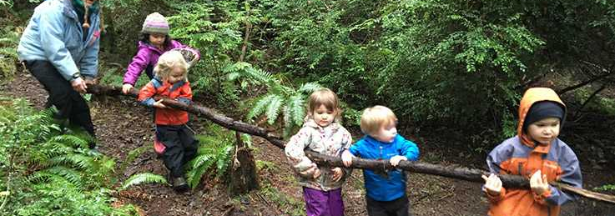
Physical Development Early Years Expectations: Nursery 3
Educational Programme:
Physical activity is vital in children’s all-round development, enabling them to pursue happy, healthy and active lives. Gross and fine motor experiences develop incrementally throughout early childhood, starting with sensory explorations and the development of a child’s strength, co- ordination and positional awareness through tummy time, crawling and play movement with both objects and adults. By creating games and providing opportunities for play both indoors and outdoors, adults can support children to develop their core strength, stability, balance, spatial awareness, co-ordination and agility. Gross motor skills provide the foundation for developing healthy bodies and social and emotional well- being. Fine motor control and precision helps with hand-eye co-ordination which is later linked to early literacy. Repeated and varied opportunities to explore and play with small world activities, puzzles, arts and crafts and the practise of using small tools, with feedback and support from adults, allow children to develop proficiency, control and confidence.
This Photo by Unknown Author is licensed under CC BY-SA

Slide 7
Early Years Expectations: Nursery
Physical Development
Area of Learning : Physical Development
Summer Term N2 (N2+) By the end of the Summer term N2 children should be able to…
• Run with spatial awareness and negotiates space successfully, adjusting speed or direction to avoid obstacles • Balance on one foot or in a squat momentarily, shifting body weight to improve stability • Go up and down stairs, or climb up apparatus, using alternate feet • Start taking part in some group activities which they make up for themselves, or in teams • Increasingly be able to use and remember sequences and patterns of movements which are related to music and rhythm • Manipulate a range of tools and equipment in one hand, e.g. paint brushes, scissors, hairbrushes, toothbrush, scarves or ribbons • Jump up into the air with both feet leaving the floor and can jump forward a small distance • Begin to understand and choose different ways of moving • Change position from standing to squatting and sitting with little effort • Hold equipment/tools consistently in the same hand, e.g., pencil, paint brush, glue spreader. • Hold a pencil consistently in the same hand using a comfortable grip for mark making, name writing, drawing etc. • Have developed finger strength and control in order to be able to manipulate and use tools independently and effectively. • Hold and operate scissors correctly to make snips in paper • Be able to put on own shoes and coat and start to use fastenings • Kick a ball, getting it to go in the desired direction towards a target • Throw a ball, in a desired direction, towards a target or friend • Catch a large, soft ball closing 2 hands on it • Be able to pour water from a larger bottle or jug into another container
Spring Term N2 (N2=) By the end of the Spring term N2 children should be able to…
• Move in different ways on different levels and surfaces being aware of obstacles e.g. other people, bikes (e.g. crawl, jump, climb, shuffle) • Move in response to music, or rhythms played on instruments such as drums or shakers with2 or more movements together. • To be able to stop on a signal or command and stay still • Turn pages in a book being able to stop at the page they want • Walk up stairs and steps using alternate feet • Start to walk down a slope • Use pincer grip to pick up small objects (e.g. shells, pebbles, pompoms) • Use a range of mark making tools to make deliberate marks on paper using the correct pressure • Stand still and upright on a spot, starting to lift one leg • Use large arm movements to create lines and circles pivoting from the shoulder and elbow • Work with other children to pass an object between them e.g. balloon, ball, scarf • Be able to put on own shoes and put on own coat • Move a ball by kicking • Move a ball by rolling or throwing

Slide 8
• Catch a slow moving skills by closing 2 hands on a slow moving objects e.g. balloons, scarves • Use 1 foot to propel themselves on a wheeled toy (e.g. 2 wheeled scooter) with control • Be able to pour water from a small bottle or jug into another container • To use spring loaded scissors to make snips in paper
Autumn Term N2 (N2-) By the end of the Autumn Term N2 children should be able to…
• Walk, run and climb on different levels and surfaces being aware of obstacles e.g. other people, bikes • Move in response to music, or rhythms played on instruments such as drums or shakers with a planned or copied action. • To be able to stop on a signal or command • Turn pages in a book, may be several at once • Walk upstairs facing forwards with both feet onto a single step at a time • Participate in finger and action rhymes, songs and games, copying and imitating the movements • Use smaller paintbrushes, dabbers and chunky mark making tools to make marks on paper, e.g. circles, lines, crosses etc. • Stand still and upright on a spot, being able to move arms • Use large arm movements to wave scarfs, ribbons in circular movements • Work with other children to lift a large object • Be able to put on a pair of wellington boots • Start to move a ball by kicking • Start to move a ball by rolling, dropping or throwing • Start to develop catching skills by closing 2 hands on a slow moving objects e.g. balloons, scarves • Use 1 foot to propel themselves on a wheeled toy (e.g. 3 wheeled scooter) • Be able to pour water from a small bottle or jug • Point to parts of the body when an adult names them • To use spring loaded scissors • Develop fine motor and manipulation skills and finger strength, such as Dough Disco, threading, using tweezers
N1 (N1+) By the end of N1 children should be able to…
• Start to walk, run and climb on different levels and surfaces being aware of obstacles e.g. other people, bikes • Move in response to music, or rhythms played on instruments such as drums or shakers • Turn pages in a board book • Walk upstairs facing forwards holding rail or hand of adult, with both feet onto a single step at a time • Participate in finger and action rhymes, songs and games, trying to copy and imitate the movements • Use paintbrushes and rollers to make marks on paper or a wall outside • Stand still and upright on a spot • Use large arm movements to wave scarfs, ribbons up and down • Be able to put on a pair of wellington boots with support • Use either hands or feet to move a ball • Use 2 feet to propel themselves on a wheeled toy If children are not meeting the demands of these statements at the end of N1, how far behind are they? One term (N1=), two terms (N1-) or working on earlier skills from Development Matters in the Birth to 3 (B, B-, B=, B+). A child who completes 5 terms of nursery, would be seen as on track if recorded as N1= at Easter of N1.

Slide 9
Literacy
Early Years Expectations: Nursery
Educational Programme:
It is crucial for children to develop a life-long love of reading. Reading
consists of two dimensions: language comprehension and word reading. Language comprehension (necessary for both reading and writing) starts from birth. It only develops when adults talk with children about the world around them and the books (stories and non-fiction) they read with them, and enjoy rhymes, poems and songs together.
Skilled word reading, taught later, involves both the speedy working out of the pronunciation of unfamiliar printed words (decoding) and the speedy recognition of familiar printed words. Writing involves transcription (spelling and handwriting) and composition (articulating ideas and structuring them in speech, before writing).

Slide 10
Early Years Expectations: Nursery
Literacy
Area of Learning : Literacy
Summer Term N2 (N2+) By the end of the Summer term N2 children should be able to..
• Ascribe meanings to signs, symbols and words that they see in different places, including those they make themselves • Talk about events and main characters in stories • Suggest what happens next in a story/how it might end • Retell a very familiar story – using at least three sentences – beginning, middle and end with picture prompts. • Look at and enjoy books independently, use illustrations to gain an understanding of story events • Distinguish between illustrations and print • Know that print carries meaning and, in English, is read from left to right and top to bottom • Be interested in words that rhyme by finishing a rhyming string, choosing a rhyming pair or beginning to offer up their own rhyming words. • Through playing language games and reading stories, children are beginning to pick out alliterative words, e.g. matching from a choice of three • Independently clap the syllables in words • Hear and says the initial sound in words e.g. can tell you the initial sound in their name, can play I spy with a few choices • Engage in activities involving segmenting and blending spoken words orally • Include mark making and early writing in their play, using more letter like shapes/letters they are familiar with. • Imitate adults’ writing by making continuous lines of shapes and symbols (early writing) from left to right • Make an attempt at writing their own name, or other names and words, using combinations of lines, circles and curves, or letter-type shapes • Independently recognise their name in different contexts • Be able to sing a selection of simple nursery rhyme all the way through e.g. Twinkle, twinkle, Humpty Dumpty, Baa, Baa Black sheep, Incy Wincy Spider. Paying attention to the rhythm/rhyme e.g. pausing in appropriate places. (3-5) • Enjoy and engage in a variety of stories, poems, songs and rhymes • Enjoy listening to longer stories and can remember much of what happens.
Spring Term N2 (N2=) By the end of the Spring term N2 children should be able to…
• Listen and engage with an unknown short story in a small group , e.g. commenting on the illustration • Listen to familiar stories with increasing attention and engagement • Know that there is a beginning and an end to a story. • Attempt to recall elements of familiar stories and will tell own stories based on stories they have heard and personal experiences. • Say what they like or dislike about a story or character, linked to their own experience of feelings. • Listen to and join in with a wider range of texts, when reading one-to-one and in small groups • Join in with repeated refrains and anticipate key events and phrases in rhymes and stories • Handle books carefully and the correct way up with growing competence • Understands that an author writes the words/story, an illustrator does the pictures and what a character is including main one. • Begin to develop phonological awareness through exposure to alliteration, rhyming words and stories, syllable demarcation, e.g. clapping syllables in new vocabulary ‘ice-cream’ • Begin to include mark making in their play, e.g. making signs and lists ‘I’m writing a shopping list’ • Independently make pre-writing shapes and symbols, e.g. circles, crosses, lines etc

Slide 11
• Recognise their own name from a selection and letters from their own name in other contexts, e.g. ‘That’s in my name’ • Can distinguish between picture and writing in their own mark making, e.g. circle for face but squiggle or zig zag for ‘words’ • Begin to copy letters from their own name and words they are interested in writing, e.g. mum, dog etc Copy syllable clapping for their own name • Know information can be relayed through signs and symbols in various forms (e.g., printed materials, digital screens and environmental/classroom print, shop signs) • Drawing is taking recognisable form, e.g. circle for face, eyes, nose, mouth etc. • When sharing a book, know that the text is what tells us what to say.
Autumn Term N2 (N2-) By the end of the Autumn Term N2 children should be able to…
• Repeat and use actions, words or phrases from familiar stories • Use learned vocabulary from familiar stories in their own play, e.g. ‘I’ll huff and I’ll puff and I’ll blow your house down’ • Fill in the missing word or phrase in a known rhyme, story or game, e.g., Humpty Dumpty sat on a ... • Have some favourite stories, rhymes, songs, poems or jingles • When sharing a book can distinguish between the print and the illustration. • Understand the words ‘cover’ and ‘pages’ in relation to books. • Be able to recognise, discover and talk about the difference between environmental and instrumental sounds in their environment. • Engage in purposeful mark making and assign meaning to their marks, e.g. ‘this is a dog’ • Beginning to choose a dominant hand for mark making • Beginning to copy pre-writing shapes, e.g. circles, lines, crosses etc. • Take part in activities that support fine motor and manipulation skills and finger strength, such as Dough Disco, using tweezers, threading
By the end of N1 (N1+) By the end of N1 children should be able to…
• Show recognition of familiar stories and rhymes, .e.g twinkle twinkle, • Enjoy rhythmic and musical activities with percussion instruments, actions rhymes and songs, clapping and joining in with actions of familiar songs and nursery rhymes • Listens to rhymes and a short story on a 1:1 / small group basis and may have favourites • Voluntarily picks up a book and mimics reading by turning the pages. • Engage in mark making, showing awareness that they’re making marks, e.g. changing coloured pen or pencil, painting with the brushes outside, using chalks. • Learn Nursery Rhymes and simple songs repeat and sing daily. If children are not meeting the demands of these statements at the end of N1, how far behind are they? One term (N1=), two terms (N1-) or working on earlier skills from Development Matters in the Birth to 3 (B, B-, B=, B+). A child who completes 5 terms of nursery, would be seen as on track if recorded as N1= at Easter of N1.

Slide 12
Assessment and Tracking
Nursery Tracking Support
Our curriculum is the progression model. If the curriculum is well planned and progressive – and children learn the planned curriculum, then they are making progress – they know and remember more. As such, our tracking for children across 9early years is simple… are they learning the planned curriculum in each of the 7 areas of learning? Are they ‘best fitting’ within the correct term’s content, in relation to what they can do and remember? And if not, at what point are they up to and what do they need to learn next?
A child who is learning the planned curriculum as expected would simply follow:
By Easter One | N1= | A child who has kept pace with the planned curriculum by the end of the Nursery 2 year , would best fit within the 3-4 Years Development Matters statements – as used to support the formulation of this document.0
By Summer One | N1+
By Christmas | N2-
By Easter | N2=
By End Of Year | N2+
Using this methodology, a child who enters nursery with typical levels of knowledge and skill expected for their age would be baselined signifying they are best fitting within the content of them prior to starting the setting. E.g. a ‘typical’ child joining an N2 class in September, would be baselined as N1+ (on track at the end of the previous term). Children who are not displaying age appropriate skills can be assessed at any point on the scale below. In essence, each ‘grade’ represents a term’s worth of curriculum content. The OFSTED 6 expectation is that most children who enter below, but not significantly below, should catch up with good teaching.

Slide 13
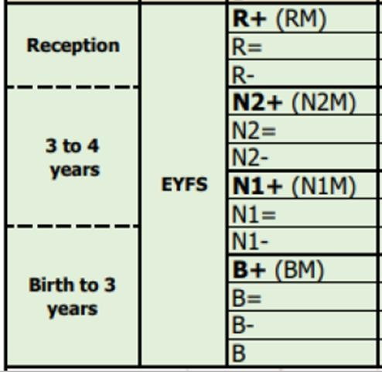
These examples are illustrative of the journey that some children may make across their time in nursery. Based on the needs of the child, some children may make more progress, others less. For example, some children could make rapid progress from lower starting points from those suggested above, and achieve the end of year target. Assessment information however, should be useful and used effectively to plan the next steps of the child.

