Slide 1
Early Years Expectations
Reception

Slide 2
Introduction
“Every child deserves the best possible start in life and support to fulfil their potential. A child’s experience in the early years has a major impact on their future life chances. A secure, safe and happy childhood is important in its own right and it provides the foundation for children to make the most of their abilities and talents as they grow up”
Early Years Foundation Stage Profile – Department for Children, Schools and Families 2012.
The Early Years Foundation Stage (EYFS) applies to children from birth to the end of reception year. At Lockwood Primary School, children are admitted into nursery in the term that they are three (when possible) and into reception in the September following their fourth birthday.
Early childhood is the foundation on which children build the rest of their lives. At Lockwood, we greatly value the importance that the EYFS plays in laying secure foundations for future learning and development.
However, we also believe that early childhood is valid in itself as part of life. It is important to view the EYFS as preparation for life and not simply preparation for the next stage of education.
When thinking about Early Years we need to have these four principles at the forefront of what we do
Every child is a unique child, who is constantly learning and can be resilient, capable, confident and self-assured
Children learn to be strong and independent through positive relationships
Children learn and develop well in enabling environments, in which their experiences respond to their individual needs and there is a strong partnership between practitioners and parents and/or carers.
Children develop and learn in different ways and at different rates.
We fully embed the three Characteristics of Effective Teaching and Learning -
playing and exploring - children investigate and experience things, and ‘have a go’
active learning - children concentrate, keep on trying if they encounter difficulties, and enjoy achievements
creating and thinking critically - children have and develop their own ideas, make links between ideas, and develop strategies for doing things.

Slide 3
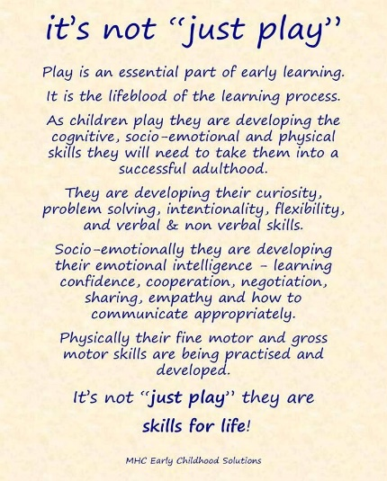
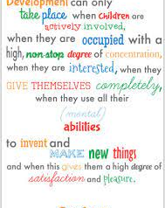
At Lockwood, we aim to support children to become independent and collaborative leaners. We will provide a broad and balanced curriculum that caters for all children’s needs and respects children’s interests and stages of development.
At Lockwood, children within EYFS are provided with a stimulating learning environment which encourages independent learning through play – a fundamental part of early learning. (Continuous Provision – this is enhanced as necessary.)
At Lockwood, we aim to support children to become independent and collaborative leaners. We will provide a broad and balanced curriculum that caters for all children’s needs and respects children’s interests and stages of development.
At Lockwood, children within EYFS are provided with a stimulating learning environment which encourages independent learning through play – a fundamental part of early learning. (Continuous Provision – this is necessary.)

Slide 4
Communication and Language
Early Years Expectations: Reception
Educational Programme:
The development of children’s spoken language underpins all seven areas of learning and development. Children’s back-and-forth interactions from an early age form the foundations for language and cognitive development. The number and quality of the conversations they have with adults and peers throughout the day in a language-rich environment is crucial. By commenting on what children are interested in or doing, and echoing back what they say with new vocabulary added, practitioners will build children's language effectively. Reading frequently to children, and engaging them actively in stories, non-fiction, rhymes and poems, and then providing them with extensive opportunities to use and embed new words in a range of contexts, will give children the opportunity to thrive. Through conversation, story-telling and role play, where children share their ideas with support and modelling from their teacher, and sensitive questioning that invites them to elaborate, children become comfortable using a rich range of vocabulary and language structures.

Slide 5
Early Years Expectations: Reception
Communication and Language | Listening, Attention and Understanding
Early Learning Goal: Communication and Language | Listening, Attention and Understanding
Children at the expected level of development will:
Listen attentively and respond to what they hear with relevant questions, comments and actions when being read to and during whole class discussions and small group interactions.
Make comments about what they have heard and ask questions to clarify their understanding.
Hold conversation when engaged in back-and-forth exchanges with their teacher and peers.
Progression towards the Early Learning Goal Progress in other areas of Listening, Attention and Understanding – Reception
R+ By the end of the Summer term and to be year 1 ready children should be able to…
Listening, Attention and Understanding: Listening, Attention and Understanding:
Able to listen attentively, for a sustained period, when being read to, during whole class discussions and during small group interactions.
Able to listen attentively to both fiction and non-fiction books.
Able to respond to what they hear by asking relevant questions, comments and or actions.
Able to generate and ask questions to clarify understanding.
Able to engage actively in conversation by contributing effectively in back and forth oral exchanges with a range of familiar adults and peers.
Responds to class books, home-school books with relevant questions to clarify meaning.
Responds to direct teaching and discussions through questioning, actions or comments.
Demonstrates effective learning behaviours and displays attentive listening in a growing range of situations: story, discussion, class and assembly
Attends effectively to support learning for elongated periods – up to thirty minutes.
Can engage effectively in conversation and engage in the roles of speaker and listener.
Can engage in conversation and turn take effectively with either another individual or a small group.
Can engage in conversation with a familiar adults and peers.
R= By the end of the Spring term children should be able to… Listening, Attention and Understanding:
Listening, Attention and Understanding:
Able to attend and engage in story sessions for at least fifteen minutes.
Able to engage in rhyming activities and display an increasing knowledge and awareness of rhyme.
Able to recall simple stories and develop comprehension of story events.
Able to listen attentively and talk about the content of non-fiction books, deepening knowledge and vocabulary.
Able to talk ‘with’ and not just ‘to’ a peer – asking questions to continue a conversation thread
Can attend and engage to a wide range of stories in school and home.
Can verbally recall the main story events to demonstrate understanding.
Can answer questions effectively to demonstrate understanding.
Can explore and recall poems and identify rhymes within.
Expands knowledge of concepts through active listening and
questioning to the sharing of information presented in non-fiction books.
Is aware and can identify effective listening principles (eyes looking, sitting comfortably).

Slide 6
R- | By the end of the Autumn Term children should be able to…
Listening, Attention and Understanding: Able to attend to simple stories and display an increasing ability to listen. Able to engage in rhyming activities. Is beginning to understand and respond to questions with increasing accuracy (what, why, where, when, who and how. Responds to two and progressively multiple step instructions. Able to talk ‘with’ and not just ‘to’ a peer Respond to questions from an adult as part of a conversation |  | Listening, Attention and Understanding: Can identify and recall favourite stories from home or school. Can answer simple questions and recall parts of a story. Enjoys listening to poems. Attends to phonic activities and listens effectively to sound production. Makes comment about stories or information without being prompted

Slide 7
Early Years Expectations: Reception
Communication and Language | Speaking
Early Learning Goal: Communication and Language | Speaking
Children at the expected level of development will:
Join in with small group, class and on-to-one discussions, offering their own ideas, using their newly learnt vocabulary.
Offer explanations for why things might happen, making use of recently introduced vocabulary.
Offer explanation for why things might happen, making use of introduced vocabulary from stories, non-fiction, rhymes and poems when appropriate.
Progression towards the Early Learning Goal Progress in other areas of Speaking – Receptio n
R+ By the end of the Summer term children should be able to…
Speaking: Speaking:
Confidently and frequently join in with small group, class and one-to-one discussions, offering their own ideas in a clear and audible voice
Demonstrate some use of their newly learnt vocabulary without being prompted to join in by an adult
Independently offer some explanations in a wide range of situations for why things might happen, making use of some recently introduced vocabulary
Offer explanations for why things might happen, making use of some introduced vocabulary from stories, non-fiction, rhymes and poems when appropriate
Confidently describe events in detail and the correct chronological order
Connect one idea or action to another using a range of connectives
Use talk to help work out problems and organise thinking and activities. Explain how things work and how they might happen
Can appropriately verbally disagree without being upset
Learn rhymes, poems and songs
Responds to direct teaching and discussions through questioning or comments
Can engage effectively in conversation and engage in the roles of speaker and listener
Can engage in conversation and turn take effectively with either another individual or a small group
Can engage in conversation with a familiar adults and peers
Develop and respond confidently to social phrases – e.g., Good morning, how are you?
R= By the end of the Spring term children should be able to… Speaking:
Speaking:
Uses new taught vocabulary in context
Connect one idea or action to another using a range of connectives – and, then, but, that
Describe events in some detail
Articulate their ideas and thoughts in sentences– use complete sentences in their everyday talk
Use talk to help work out problems and organise thinking and activities. Explain how things work and how they might happen – encourage children to talk about their problem together and come up with ideas for how to solve it
Can verbally recall the main story events to demonstrate understanding and the correct use of specific vocabulary
Can answer questions effectively to demonstrate understanding using recently learnt vocabulary correctly
Can explore and recall poems and identify rhymes within
Expands knowledge of concepts through active listening to the sharing of information presented in non-fiction books, demonstrating the competent use of newly learnt vocabulary

Slide 8
Use social phrases without prompting Retell a story, once they have developed a deep familiarity with the text; some as exact repetition and some in their own words Learn rhymes, poems and songs |  | Develop and begin to respond to social phrases – e.g., Good morning, how are you?
R- | By the end of the Autumn Term children should be able to…
Speaking: Look at and listen carefully to the person they are speaking to Begin to learn new vocabulary Wait for their turn to speak and respond appropriately Speak in a full sentence Begin to develop their own narratives (tell their own stories/versions of a story)and explanations by connecting events Begin to connect one idea or action to another using a range of connectives – and, then Use talk to help work out problems and organise thinking and activities. Explain how things work and how they might happen – think out loud how to work things out Learn rhymes, poems and songs |  | Speaking: Can identify and recall favourite stories from home or school and explain why Can ask simple questions and recall parts of a story Enjoys learning and saying poems and nursery rhymes Begin to develop social phrases – e.g., Good morning, how are you?

Slide 9
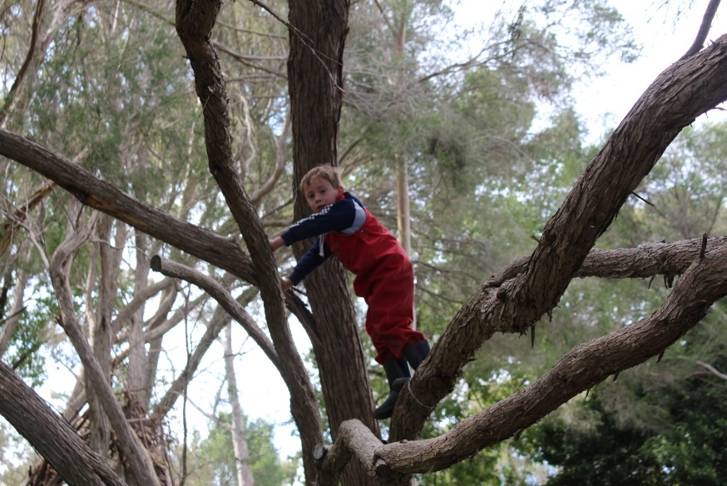
Physical Development
Early Years Expectations: Reception
Educational Programme:
Physical activity is vital in children’s all-round development, enabling them to pursue happy, healthy and active lives. Gross and fine motor experiences develop incrementally throughout early childhood, starting with sensory explorations and the development of a child’s strength, co-ordination and positional awareness through tummy time, crawling and play movement with both objects and adults. By creating games and providing opportunities for play both indoors and outdoors, adults can support children to develop their core strength, stability, balance, spatial awareness, co-ordination and agility. Gross motor skills provide the foundation for developing healthy bodies and social and emotional well-being. Fine motor control and precision helps with hand-eye co-ordination which is later linked to early literacy. Repeated and varied opportunities to explore and play with small world activities, puzzles, arts and crafts and the practise of using small tools, with feedback and support from adults, allow children to develop proficiency, control and confidence.
This Photo by Unknown Author is licensed under CC BY

Slide 10
Early Years Expectations: Reception
Physical Development | Fine Motor Skills
Early Learning Goal: Physical Development| Fine Motor Skills
Children at the expected level of development will: Be able to hold a pencil effectively in preparation for fluent writing – using the tripod grip in almost all cases. Be able to use a range of small tools, including scissors, paint brushes and cutlery. Begin to show accuracy and care when drawing
Progression towards the Early Learning Goal |  | Progress in other areas of physical development – Reception
R+ | By the end of the Summer term and to be year 1 ready children should be able to…
Hold a pencil effectively and with good control- using the tripod grip in almost all cases. Hold a pencil close to the point. Have a preference for a dominant hand, consistently. Form recognisable letters, most of which are correctly formed. Use scissors correctly to cut around a picture along the lines. Use paint brushes with control to paint recognisable pictures. Uses cutlery effectively including cutting their food with a knife and fork. Show more accuracy and care when drawing. Draw recognisable pictures with more details e.g. a person should have a head, body, arms and legs from the body, eyes, nose, mouth, hair etc. |  | Children are able to show the skills of colouring a range of images and pictures. Children are beginning to write on a line. Children will be given the experience of sewing and woodwork Use tweezers to pick up small objects such as pompoms or marbles. Thread small beads on to a piece of sting/ wool.
R= | By the end of the Spring term children should be able to…
Begin to use a range of tools with more accuracy e.g. pencils, paintbrushes, scissors, tweezers Beginning to use a dominant hand. Begin to draw recognisable pictures. Begin to use a knife to cut their food. Confidently and safely use large and small apparatus outside. Write their names forming the letters correctly. Form recognisable letters. Dress themselves including fastening zips and beginning to fasten buttons. Go to the toilet independently and wash their hands |  | Thread small beads on to a pipe cleaner. Thread laces and ribbons through pre-made holes such as threading cards, weaving frames etc. Children are given the opportunity to work with clay. Children can use spray bottles with one hand.
R- | By the end of the Autumn Term children should be able to…
Draw lines and circles using anti-clockwise movements. Write their name. Make snips with scissors. Use a fork and spoon to eat with and begin to use a knife. Put on their own coat and fasten their zip. Dress with help. Become more independent in managing their own hygiene needs such as going to the toilet, washing hands etc. Remain dry and clean throughout the day. |  | Thread beads/ cotton reels on to a lace. Thread pasta on to a piece of string or wool. Children dance with scarves. Children can tip and pour in to containers with a small opening e.g. measuring cylinders, plastic bottles etc. Children can manipulate play dough. Children can use spray bottles using 2 hands.

Slide 11
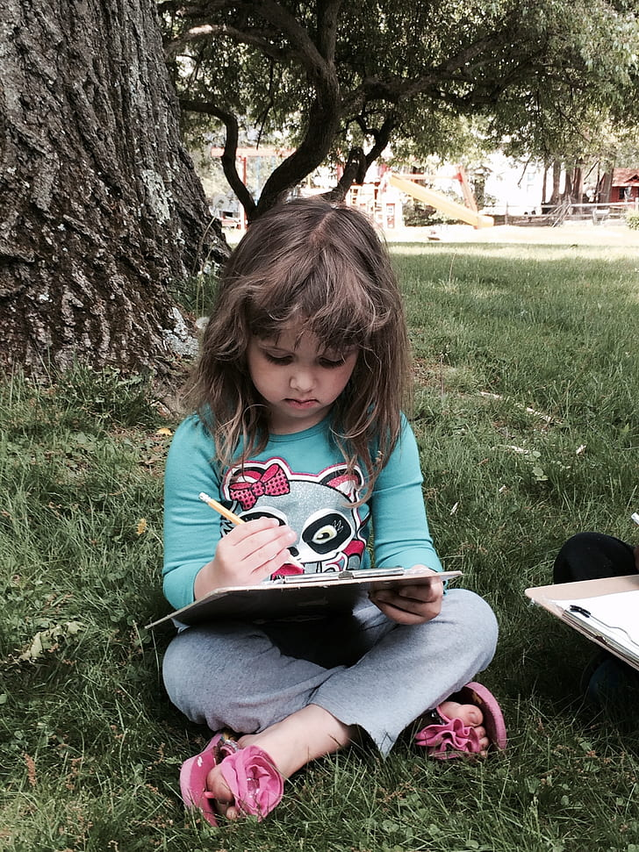
Literacy
Early Years Expectations: Reception
Educational Programme:
It is crucial for children to develop a life-long love of reading. Reading consists of two dimensions: language comprehension and word reading. Language comprehension (necessary for both reading and writing) starts from birth. It only develops when adults talk with children about the world around them and the books (stories and non-fiction) they read with them, and enjoy rhymes, poems and songs together. Skilled word reading, taught later, involves both the speedy working out of the pronunciation of unfamiliar printed words (decoding) and the speedy recognition of familiar printed words. Writing involves transcription (spelling and handwriting) and composition (articulating ideas and structuring them in speech, before writing).

Slide 12
Early Years Expectation: Reception
Literacy | Comprehension
Early Learning Goal: Literacy | Comprehension
Children at the expected level of development will:
Demonstrate understanding of what has been read to me by retelling stories and narratives using my own and recently introduced vocabulary;
Anticipate, where appropriate, events in stories;
Use and understand recently introduced vocabulary during discussions about stories, non-fiction, rhymes and poems and during role-play.
Progression towards the Early Learning Goal
Progress in other areas of literacy curriculum –Reception
R+ By the end of the Summer term and to be year 1 ready children should be able to…
Re-read books to build up their confidence in word reading, their fluency and their understanding and enjoyment
Engage in extended conversations about stories, demonstrating the correct use of new vocabulary and demonstrating their understanding by using the new vocabulary in the correct context and in conversation
Retell a familiar story/traditional tale and include repeated words, phrases and refrains correctly
Answer simple questions about a familiar book/text in shared or independent writing
Sequence four/five pictures in order – beginning, middle and end, using narrative language and new vocabulary to retell the story
Make detailed predictions about how the story might end, develop and anticipate key events within the story
Answer questions about a story and discuss the characters’ feelings
Describe the main events in stories they have read in detail
Build up a repertoire of their favourite nursery rhymes, stories songs, poems and non-fiction text
Listen attentively with sustained concentration to follow a story without pictures or props and can listen in a larger group for example in assembly
Respond to a range of texts by asking and answering appropriate questions
Engage with, and respond showing enjoyment, to a range of more challenging texts
Identify whether a word is a simple noun or another kind of word
Use expression when reading aloud, demonstrating an awareness of what a question mark and exclamation mark are
R= By the end of the Spring term children should be able to…
Read and understand simple phrases and sentences – based on their phonic ability
Engage in extended conversations about stories, learning new vocabulary
Listen to and talk about simple and topic related non-fiction books to develop a deep familiarity with new knowledge and vocabulary. (Taken from Communication & Language – Listening, attention & understanding)
Join in with and continue predictable words, phrases and refrains
Answer simple questions about a familiar book/text orally
Read and understand phrases and captions – link directly to their phonic knowledge stage of development
Describe the main events in stories they have read – beginning, middle and end in detail
Build up a repertoire of the favourite nursery rhymes and stories
Aware when they haven't understood something and are able to say, for example, 'I don’t understand'
Able to sustain attention for a given period of time depending on the situation, task or activity
They listen attentively and respond positively to a variety of assemblies
Understand simple sentences - from Phase 3 'Letters and Sounds' or equivalent
Link a story to their own lives and explain why/how

Slide 13
Sequence three pictures in order from a familiar story – beginning, middle and end, using narrative language to retell the story Make predictions about how the story might end and how the story might develop To be able to retell/join in with retelling some traditional tales |  | Use pictures/illustrations to talk about how a character is feeling Begin to use expression when reading aloud, demonstrating some awareness of what a question mark and exclamation mark are
R- | By the end of the Autumn Term children should be able to…
Understand the five concepts: print has meaning, print can have different purposes, we read English text form left to right and from top to bottom, the names of the different parts of a book, page sequencing Engage in story times. (Taken from Communication & Language – Listening, attention & understanding) Join in with predictable words, phrases and refrains Listen carefully to rhymes and songs, paying attention to how they sound. (Taken from Communication & Language – Listening, attention & understanding) Engage in non-fiction books. (Taken from Communication & Language – Listening, attention & understanding) Begin to answer simple questions about a familiar book/text orally Begin to listen to and talk about simple and topic related non-fiction books to develop a deep familiarity with new knowledge and vocabulary. (Taken from Communication & Language – Listening, attention & understanding) Understand how to listen carefully and why listening is important. (Taken from Communication & Language – Listening, attention & understanding) Retell a story, once they have developed a deep familiarity with the text; some as exact repetition and some in their own words. (Taken from Communication & Language – Listening, attention & understanding/Speaking) Listen to and talk about stories to build familiarity and understanding. (Taken from Communication & Language – Listening, attention & understanding) Begin to read and understand simple words (CVC) – link directly to their phonic knowledge stage of development Sequence three pictures in order from a very familiar and well-known story – beginning, middle and end Identify the main characters in a familiar story/traditional tale Begin to make simple predictions about how the story might end To be able to retell/join in with retelling a traditional tale – e.g., The Three Billy Goats Gruff, Goldilocks and the Three Bears and The Three Little Pigs |  | Begin to describe the main events in stories they have read with questioning to develop an understanding of the developing story – beginning, middle and end Build up a repertoire of their favourite nursery rhymes Wait for their turn to speak and respond appropriately Listen attentively in a range of situations Respond to an appropriate cue and listen attentively to the instructions given Able to sustain attention for a given period of time depending on the situation, task or activity Able to listen to stories and are able to anticipate key events by making sensible suggestions from the story read so far Understand simple sentences - from Phase 2 'Letters and Sounds' or equivalent Begin to link a story to their own lives - “ I have a brother too!” Begin to use pictures/illustrations to talk about how a character is feeling

Slide 14
Early Years Expectations: Reception
Literacy | Word Reading
Early Learning Goal: Literacy | Word Reading
Children at the expected level of development will: Say a sound for each letter in the alphabet and at least 10 digraphs; Read words consistent with their phonic knowledge by sound-blending; Read aloud simple sentences and books that are consistent with their phonic knowledge, including some common exception words.
Progression towards the Early Learning Goal |  | Progress in other areas of literacy curriculum – Reception
R+ | By the end of the Summer term and to be year 1 ready children should be able to..
Re read what they have written to check that it makes sense. Begin to read Set 2 sounds ay ee igh oo oo ar or air ou oy Begin to read some words containing these Set 2 sounds Confidently read words containing Set 1 sounds building fluency Read green or purple storybooks- matched to our Read write inc programme Read simple phrases and sentences made up of words with known letter-sound correspondences and, where necessary, a few exception words. Read common exception words matched to the school’s phonic programme – Read, Write inc. |  | Read words containing more than one syllable. Read additional Common Exception words as they come across them and retain a wider range than prescribed. Beginning to read and identify nonsense words
R= | By the end of the Spring term children should be able to…
Read Set 1 special friends sh ch th ng nk qu Begin to read some words which contain Set 1 special friends sh ch th ng nk qu Build speed of reading words containing Set 1 sounds Have a secure blending of CVC words Read short Ditty sheets and red story books- matched to our Read write inc programme Read some common exception words matched to our Read write inc programme |  | Decode words using their phonic knowledge Understand simple sentences Describe the main events in stories they have. Choose and read a range of books independently to read for pleasure and with an adult
R- | By the end of the Autumn Term children should be able to…
Understand the five concepts: print has meaning, print can have different purposes, we read English text form left to right and from top to bottom, the names of the different parts of a book, page sequencing. Develop their phonological awareness, so that they can: spot and suggest rhymes, count or clap syllables in a word, recognise words with the same initial sound, such as money and mother. Read individual letters by saying the sounds for them – m a s d t I n p g o c k u b f e l h r j v w x y z Blend sounds into words, so that they can read short words made up of known letter-sound correspondences. (Set 1 single letter sounds) |  | Demonstrate understanding when talking with others about what they have read. For example, name of characters, where the story is set, what happened in the story. Talk about what they have read. Begin to read some CVC words Knows how to hold and handle a book, turning pages and knows key parts of a book, title, cover, author, illustrator, contents page.

Slide 15
Early Years Expectations: Reception
Literacy | Writing
Early Learning Goal: Literacy | Writing
Children at the expected level of development will:
I can write recognisable letters, most of which are correctly formed;
I can spell words by identifying sounds in them and representing the sounds with a letter or letters;
I can write simple phrases and sentences that can be read by others.
Progression towards the Early Learning Goal
Progress in other areas of literacy curriculum – Reception
R+ By the end of the Summer term and to be year 1 ready children should be able to…
Write full name accurately including capital letters
Form recognisable letters, most of which are correctly formed (sequence of movement and orientation)
Write CVC words with more confidence, by segmenting the sounds and then writing the sound with letter/s Compose a sentence orally and hold it, remembering what they are going to write.
Write short sentences with words with known sound-letter correspondences.
Re-read writing to check that it makes sense.
Hold a pencil effectively and with good control, using tripod grip and holding close to point
Name the letters of the alphabet (year 1 objective)
Can write letters on the line
Use the full width of the page, writing from left to right, top to bottom.
To use finger spaces, capital letters and full stops in their writing (year 1 objective)
Write 2-syllable words containing taught sounds
To understand and use simple adjectives (colour and size) e.g. 'The black dog is in the mud.'
To write for a range of audience and purposes (postcards, letters, captions, recounts, lists…)
Beginning to write in chronological order.
Children are introduced to dictionaries, sound and word mats as a tool to support independence.
To use a tripod grip to hold a pencil.
R= By the end of the Spring term children should be able to…
Copy write full name and begin to write it from memory (forming letters correctly including capitals).
Form some lower-case letters accurately
Developing writing CVC words
To begin to write captions and phrases
To be able to write first name accurately
To sit correctly at a table with 2 legs on the floor (chair tucked in, no swinging on chair)
To hold a pencil using a comfortable grip and use it effectively.
To tilt the paper according to writing hand and hold the paper still with other hand
To know that letters have a name and letters have a sound
To know that letters can be represented by upper and lower case letters
To begin to sing the alphabet song, naming the letters of the alphabet (Year 1 objective)
Aware of syllables in words – break it up
To use capital I for personal pronoun

Slide 16
 | By the end of the Autumn Term children should be able to…
Write some letters from their name from memory.. Begin to form lower-case letters correctly as they learn them Begin to Write CVC words with support by segmenting the sounds and then writing the sound with letter/s Begin to represent some sounds correctly in their writing e.g initial sounds |  | Begin to sit correctly at a table with 2 legs on the floor (support to tuck chair in and not to swing). To hold a pencil using a comfortable grip with a little support To use the other hand to hold the paper still with support To over-write some Set 1 letters accurately, correct starting point, sequence of movement and orientation, letters on the line Aware of syllables in name – clap it out The children are exposed to a wide range of texts (story, postcards, letters, captions, signs, recounts, lists …). Aware that writing goes from left to right – adult to model

Slide 17
Reception Tracking Support
Our curriculum is the progression model. If the curriculum is well planned and progressive – and children learn the planned curriculum, then they are making progress – they know and remember more. As such, our tracking for children across is early years is simple… are they learning the planned curriculum? And if not, at what point are they up to?
A child who is learning the planned curriculum as expected would simply follow:
By Christmas | R- | A child who has kept pace with the planned curriculum by the end of the year , would achieve the national Early Learning Goals
By Easter | R=
By End Of Year | R+
Using this methodology, a child who enters reception with typical levels of knowledge and skill expected for their age would be baselined as N2+ (meeting the demands of the N2 curriculum). Children who are not displaying age appropriate skills can be assessed at any point on the scale opposite. In essence, each ‘grade’ represents a term’s worth of curriculum content. The OFSTED – and school - expectation is that most children who enter below, but not significantly below, should catch up with good teaching.

