Slide 1

Chairs Briefing
9 October 2020
Notes:
CB

Slide 2
Agenda
Welcome | Karen Smith
SEND and the role and expectations of Governance | 11.05-11.20
Ofsted interim visits | 11.20-11.40
School visits | 11.40-11.50
Frontline portal | 11.50-12.00
Q&A | Ideas to be emailed

Slide 3
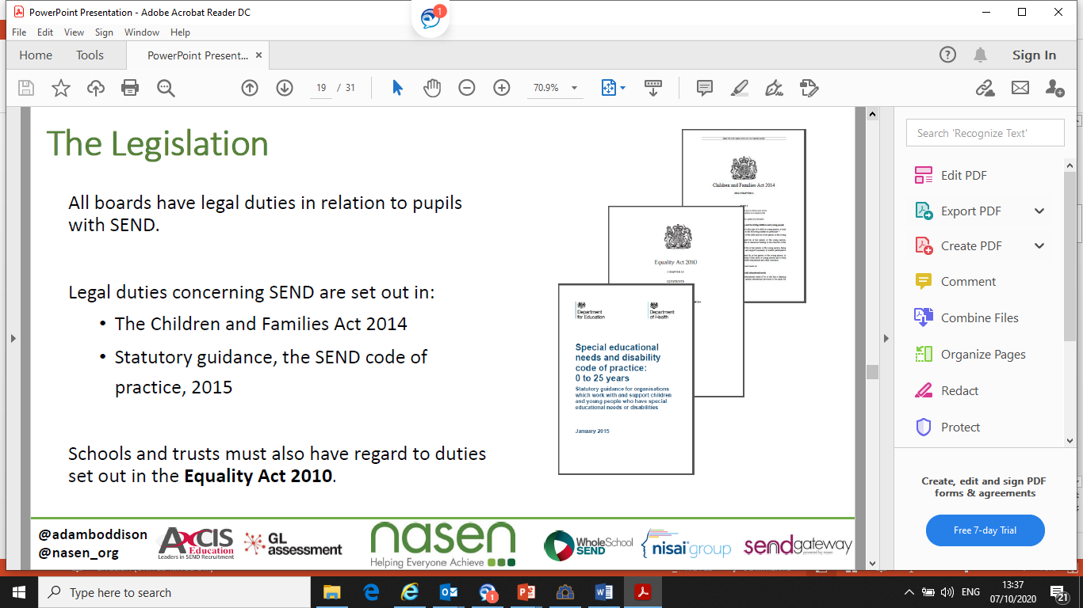
SEND and the role and expectations of Governance

Slide 4
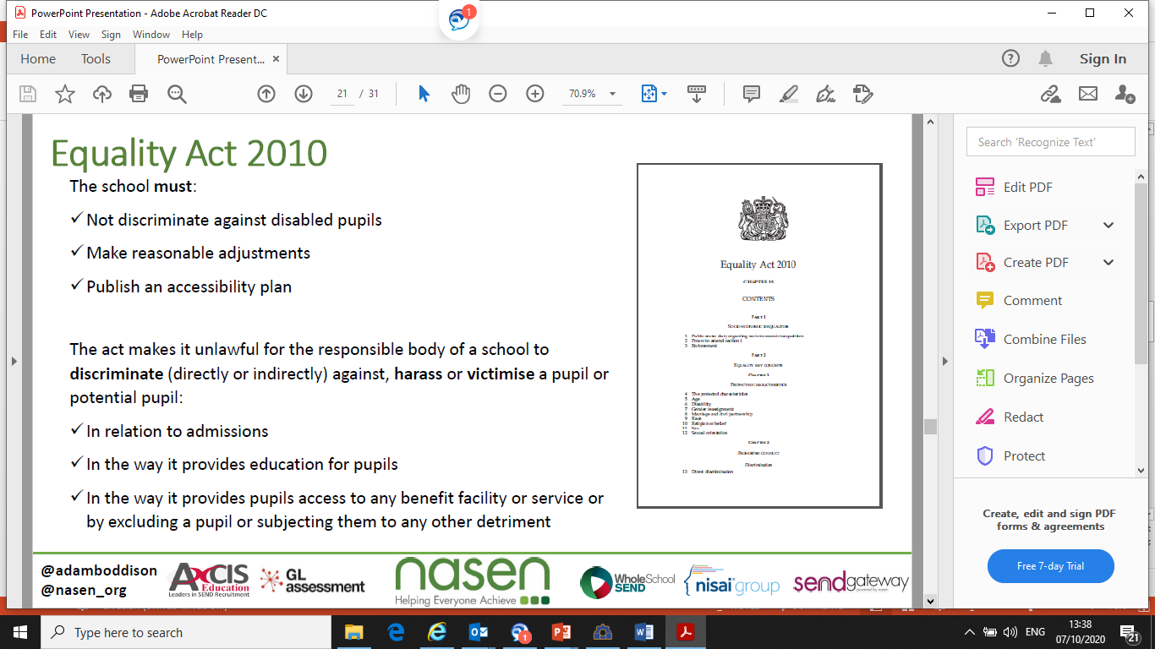

Slide 5
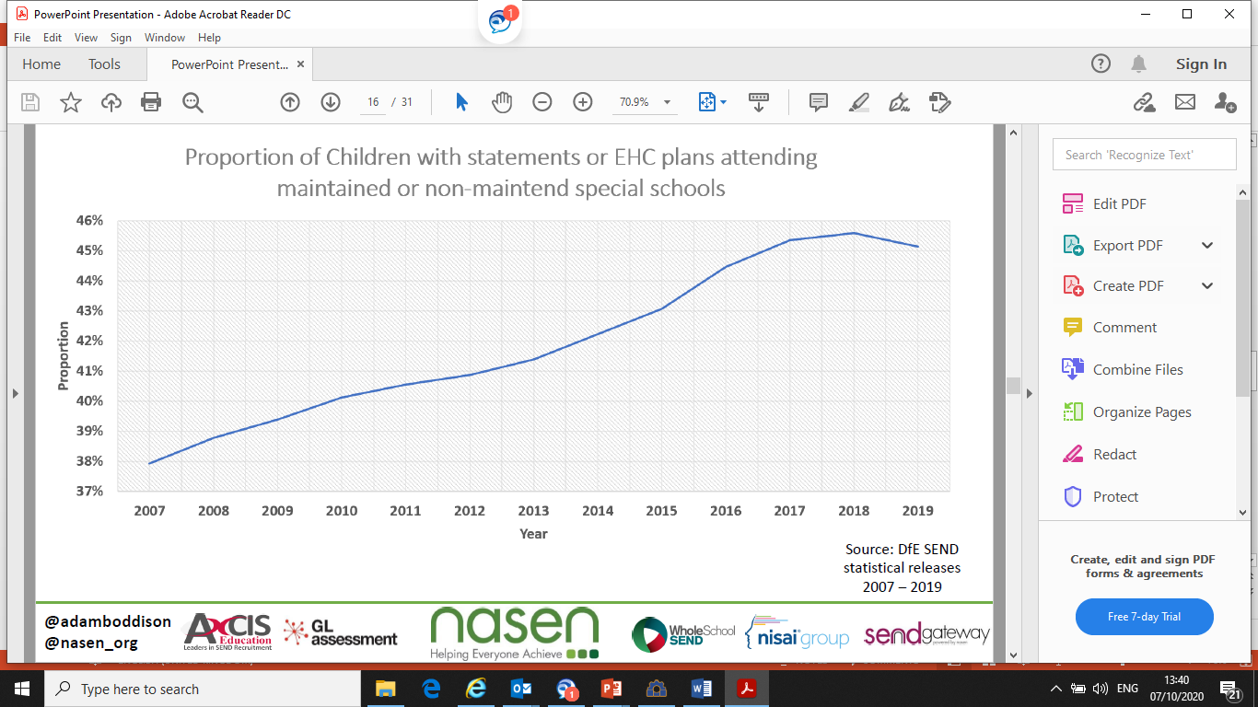

Slide 6
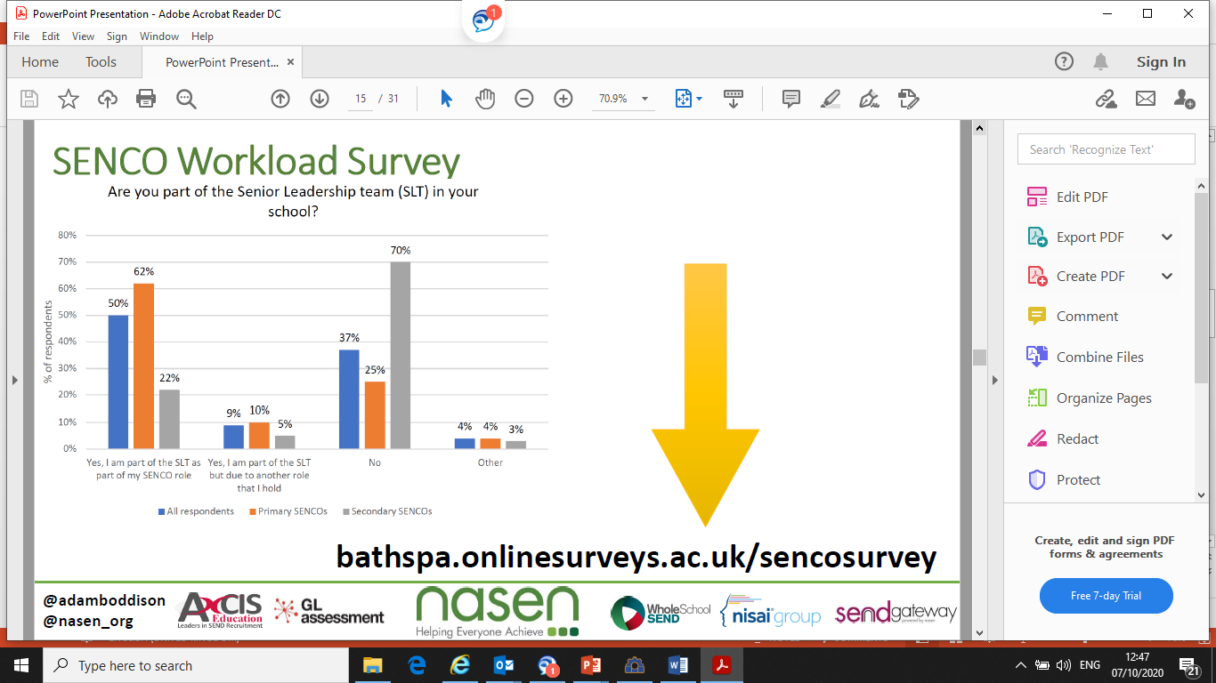

Slide 7
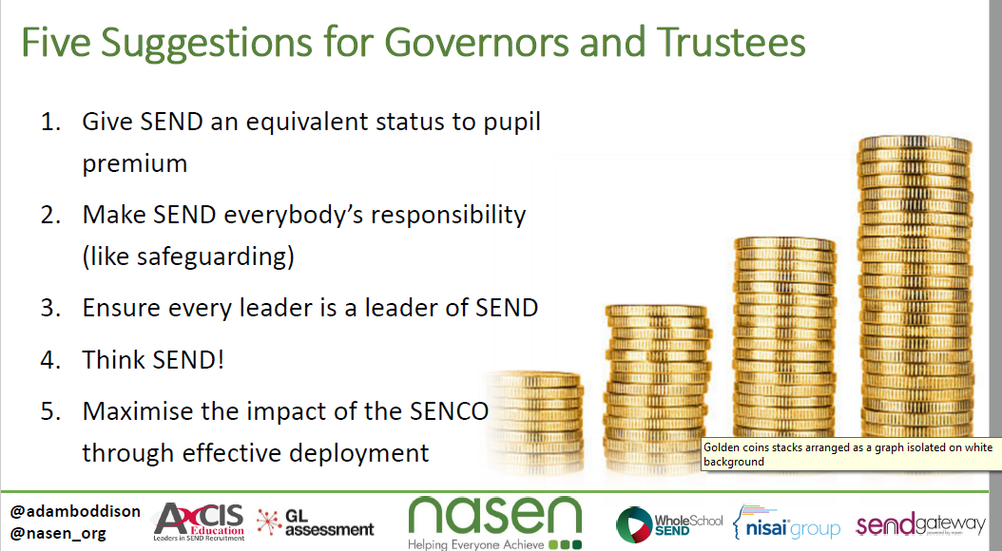

Slide 8
Ofsted interim visits
Notes:
Interim visits will take place from 28 September 2020 to December 2020 inclusive.

Slide 9
Ofsted interim visits
The purpose of interim visits
These interim visits are to reassure and inform parents, government and the public about how schools are managing the return to full education for all pupils.
How are schools selected for interim visits
The sample will include an range of requires improvement, good and outstanding:
•approximately 1,200 schools across all Ofsted grades, including all schools that are currently inadequate
•maintained schools, academies and free schools, special schools and centres of alternative provision
•those in cities and coastal, town or rural communities
•as even a spread as possible across different Ofsted regions and local authorities
No schools are legally exempt from an interim visit, because these are not full inspections.

Slide 10
Ofsted interim visits
Length and timing of interim visits
Visits will normally last for a day, 10am to 4 pm
The purpose of the notification call is to:
•explain the purpose of the visit
•allow the headteacher and lead HMI some time to discuss the context of the school, including the current circumstances in light of COVID-19
•allow the lead HMI and the headteacher to discuss the protective measures in place, including the arrangements for having visitors on site
•agree practical arrangements, such as who the inspectors will meet; this will normally include the headteacher and designated safeguarding leader, though headteachers are free to invite other leaders to participate in the visit, at their discretion
Notifying the school of a visit
The lead HMI will normally contact the school by telephone to announce the visit around 10am on the school day before a visit.

Slide 11
Ofsted interim visits
Methodology of visits and evidence collection
Inspectors will work collaboratively with leaders to understand:
•the barriers that the school has faced, and may still be facing, in managing the return to full education for all pupils
•how leaders are ensuring that pupils resume learning the school’s curriculum, including contingency planning for the use of remote education and the use of catch-up funding
•how pupils are settling back into expected routines and behaviour, including regular attendance
•how any identified and specific issues related to special educational needs, disabilities, health, care, well-being issues for particular groups of pupils are being addressed
•the school’s safeguarding arrangements (focusing on arrangements at the time of the visit but potentially also looking at what was in place at the start of the COVID-19 response)
Notes:
Letter to the school
Check central school record and that safer recruitment has been followed for any staff employed during the school closure.
Within 18 working days of the end of the visit, we will write to the school, setting out in a draft letter what inspectors found. This will have been quality assured. We may share the draft letter or findings with other public bodies.
The school will have 5 working days to comment on the draft letter, process and findings. We will consider all comments and we will respond to the comments when we share the final letter with the school within a maximum of 30 working days after the visit, although it will likely be much sooner.

Slide 12
School visits
Virtual meetings remain except where specific requests are made
LA and school risk assessments adhered to
Network meetings: EYFS, DSL, Literacy, Chairs
Re-entry protocols implemented
RCBC
All therapy is available back in schools.
School visits and audits are to take place under school risk assessment. For support in:
Achievement contact Martin Featherstone (Martin.Featherstone@redcar-cleveland.gov.uk)
SEND contact Michelle Henley (Michelle.Henley@redcar-cleveland.gov.uk)
Inclusion contact Julie McDowell (Julie.McDowell@redcar-cleveland.gov.uk)

Slide 13

Frontline on-line portal

Slide 14
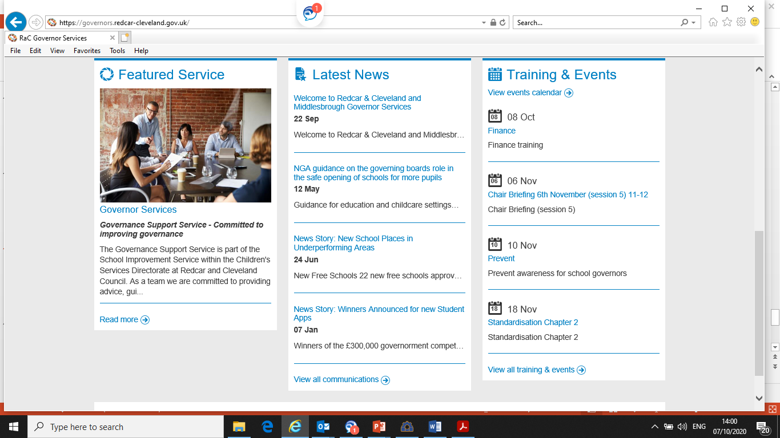
Frontline on-line portal

Slide 15
Questions

Slide 16
These are:
• Redcar and Cleveland – 61 confirmed cases per 100,000 of population;
• Darlington – 91 confirmed cases per 100,000 of population;
• Middlesbrough – 121 confirmed cases per 100,000 of population;
• Hartlepool – 121 confirmed cases per 100,000 of population;
• Stockton – 91 confirmed cases per 100,000 of population.
To put this into context, six of the seven local authority areas in the North of the region have an infection rate of more than 100 cases per 100,000 of population. County Durham is the exception but its infection rate is just below 100. Newcastle, the area which is currently experiencing the most severe problems in the North East has an infection rate of around 250 cases per 100,000 population.
The infection rate fluctuates depending on the number of cases each day. The rate in Redcar and Cleveland today is 59.1.

