Slide 1
Early Years Expectations
Reception

Slide 2
Introduction
“Every child deserves the best possible start in life and support to fulfil their potential. A child’s experience in the early years has a major impact on their future life chances. A secure, safe and happy childhood is important in its own right and it provides the foundation for children to make the most of their abilities and talents as they grow up”
Early Years Foundation Stage Profile – Department for Children, Schools and Families 2012.
The Early Years Foundation Stage (EYFS) applies to children from birth to the end of reception year. At Lockwood Primary School, children are admitted into nursery in the term that they are three (when possible) and into reception in the September following their fourth birthday.
Early childhood is the foundation on which children build the rest of their lives. At Lockwood, we greatly value the importance that the EYFS plays in laying secure foundations for future learning and development.
However, we also believe that early childhood is valid in itself as part of life. It is important to view the EYFS as preparation for life and not simply preparation for the next stage of education.
When thinking about Early Years we need to have these four principles at the forefront of what we do
Every child is a unique child, who is constantly learning and can be resilient, capable, confident and self-assured
Children learn to be strong and independent through positive relationships
Children learn and develop well in enabling environments, in which their experiences respond to their individual needs and there is a strong partnership between practitioners and parents and/or carers.
Children develop and learn in different ways and at different rates.
We fully embed the three Characteristics of Effective Teaching and Learning -
playing and exploring - children investigate and experience things, and ‘have a go’
active learning - children concentrate, keep on trying if they encounter difficulties, and enjoy achievements
creating and thinking critically - children have and develop their own ideas, make links between ideas, and develop strategies for doing things.

Slide 3
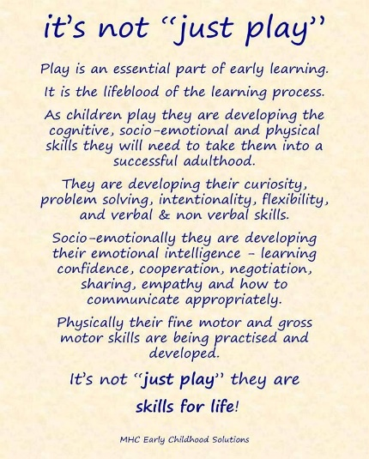
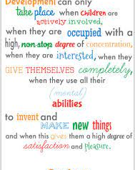
At Lockwood, we aim to support children to become independent and collaborative leaners. We will provide a broad and balanced curriculum that caters for all children’s needs and respects children’s interests and stages of development.
At Lockwood, children within EYFS are provided with a stimulating learning environment which encourages independent learning through play – a fundamental part of early learning. (Continuous Provision – this is enhanced as necessary.)
At Lockwood, we aim to support children to become independent and collaborative leaners. We will provide a broad and balanced curriculum that caters for all children’s needs and respects children’s interests and stages of development.
At Lockwood, children within EYFS are provided with a stimulating learning environment which encourages independent learning through play – a fundamental part of early learning. (Continuous Provision – this is necessary.)

Slide 4
Communication and Language
Early Years Expectations: Reception
Educational Programme:
The development of children’s spoken language underpins all seven areas of learning and development. Children’s back-and-forth interactions from an early age form the foundations for language and cognitive development. The number and quality of the conversations they have with adults and peers throughout the day in a language-rich environment is crucial. By commenting on what children are interested in or doing, and echoing back what they say with new vocabulary added, practitioners will build children's language effectively. Reading frequently to children, and engaging them actively in stories, non-fiction, rhymes and poems, and then providing them with extensive opportunities to use and embed new words in a range of contexts, will give children the opportunity to thrive. Through conversation, story-telling and role play, where children share their ideas with support and modelling from their teacher, and sensitive questioning that invites them to elaborate, children become comfortable using a rich range of vocabulary and language structures.

Slide 5
Early Years Expectations: Reception
Communication and Language | Listening, Attention and Understanding
Early Learning Goal: Communication and Language | Listening, Attention and Understanding
Children at the expected level of development will:
Listen attentively and respond to what they hear with relevant questions, comments and actions when being read to and during whole class discussions and small group interactions.
Make comments about what they have heard and ask questions to clarify their understanding.
Hold conversation when engaged in back-and-forth exchanges with their teacher and peers.
Progression towards the Early Learning Goal Progress in other areas of Listening, Attention and Understanding – Reception
R+ By the end of the Summer term and to be year 1 ready children should be able to…
Listening, Attention and Understanding: Listening, Attention and Understanding:
Able to listen attentively, for a sustained period, when being read to, during whole class discussions and during small group interactions.
Able to listen attentively to both fiction and non-fiction books.
Able to respond to what they hear by asking relevant questions, comments and or actions.
Able to generate and ask questions to clarify understanding.
Able to engage actively in conversation by contributing effectively in back and forth oral exchanges with a range of familiar adults and peers.
Responds to class books, home-school books with relevant questions to clarify meaning.
Responds to direct teaching and discussions through questioning, actions or comments.
Demonstrates effective learning behaviours and displays attentive listening in a growing range of situations: story, discussion, class and assembly
Attends effectively to support learning for elongated periods – up to thirty minutes.
Can engage effectively in conversation and engage in the roles of speaker and listener.
Can engage in conversation and turn take effectively with either another individual or a small group.
Can engage in conversation with a familiar adults and peers.
R= By the end of the Spring term children should be able to… Listening, Attention and Understanding:
Listening, Attention and Understanding:
Able to attend and engage in story sessions for at least fifteen minutes.
Able to engage in rhyming activities and display an increasing knowledge and awareness of rhyme.
Able to recall simple stories and develop comprehension of story events.
Able to listen attentively and talk about the content of non-fiction books, deepening knowledge and vocabulary.
Able to talk ‘with’ and not just ‘to’ a peer – asking questions to continue a conversation thread
Can attend and engage to a wide range of stories in school and home.
Can verbally recall the main story events to demonstrate understanding.
Can answer questions effectively to demonstrate understanding.
Can explore and recall poems and identify rhymes within.
Expands knowledge of concepts through active listening and
questioning to the sharing of information presented in non-fiction books.
Is aware and can identify effective listening principles (eyes looking, sitting comfortably).

Slide 6
R- | By the end of the Autumn Term children should be able to…
Listening, Attention and Understanding: Able to attend to simple stories and display an increasing ability to listen. Able to engage in rhyming activities. Is beginning to understand and respond to questions with increasing accuracy (what, why, where, when, who and how. Responds to two and progressively multiple step instructions. Able to talk ‘with’ and not just ‘to’ a peer Respond to questions from an adult as part of a conversation |  | Listening, Attention and Understanding: Can identify and recall favourite stories from home or school. Can answer simple questions and recall parts of a story. Enjoys listening to poems. Attends to phonic activities and listens effectively to sound production. Makes comment about stories or information without being prompted

Slide 7
Early Years Expectations: Reception
Communication and Language | Speaking
Early Learning Goal: Communication and Language | Speaking
Children at the expected level of development will:
Join in with small group, class and on-to-one discussions, offering their own ideas, using their newly learnt vocabulary.
Offer explanations for why things might happen, making use of recently introduced vocabulary.
Offer explanation for why things might happen, making use of introduced vocabulary from stories, non-fiction, rhymes and poems when appropriate.
Progression towards the Early Learning Goal Progress in other areas of Speaking – Receptio n
R+ By the end of the Summer term children should be able to…
Speaking: Speaking:
Confidently and frequently join in with small group, class and one-to-one discussions, offering their own ideas in a clear and audible voice
Demonstrate some use of their newly learnt vocabulary without being prompted to join in by an adult
Independently offer some explanations in a wide range of situations for why things might happen, making use of some recently introduced vocabulary
Offer explanations for why things might happen, making use of some introduced vocabulary from stories, non-fiction, rhymes and poems when appropriate
Confidently describe events in detail and the correct chronological order
Connect one idea or action to another using a range of connectives
Use talk to help work out problems and organise thinking and activities. Explain how things work and how they might happen
Can appropriately verbally disagree without being upset
Learn rhymes, poems and songs
Responds to direct teaching and discussions through questioning or comments
Can engage effectively in conversation and engage in the roles of speaker and listener
Can engage in conversation and turn take effectively with either another individual or a small group
Can engage in conversation with a familiar adults and peers
Develop and respond confidently to social phrases – e.g., Good morning, how are you?
R= By the end of the Spring term children should be able to… Speaking:
Speaking:
Uses new taught vocabulary in context
Connect one idea or action to another using a range of connectives – and, then, but, that
Describe events in some detail
Articulate their ideas and thoughts in sentences– use complete sentences in their everyday talk
Use talk to help work out problems and organise thinking and activities. Explain how things work and how they might happen – encourage children to talk about their problem together and come up with ideas for how to solve it
Can verbally recall the main story events to demonstrate understanding and the correct use of specific vocabulary
Can answer questions effectively to demonstrate understanding using recently learnt vocabulary correctly
Can explore and recall poems and identify rhymes within
Expands knowledge of concepts through active listening to the sharing of information presented in non-fiction books, demonstrating the competent use of newly learnt vocabulary

Slide 8
Use social phrases without prompting Retell a story, once they have developed a deep familiarity with the text; some as exact repetition and some in their own words Learn rhymes, poems and songs |  | Develop and begin to respond to social phrases – e.g., Good morning, how are you?
R- | By the end of the Autumn Term children should be able to…
Speaking: Look at and listen carefully to the person they are speaking to Begin to learn new vocabulary Wait for their turn to speak and respond appropriately Speak in a full sentence Begin to develop their own narratives (tell their own stories/versions of a story)and explanations by connecting events Begin to connect one idea or action to another using a range of connectives – and, then Use talk to help work out problems and organise thinking and activities. Explain how things work and how they might happen – think out loud how to work things out Learn rhymes, poems and songs |  | Speaking: Can identify and recall favourite stories from home or school and explain why Can ask simple questions and recall parts of a story Enjoys learning and saying poems and nursery rhymes Begin to develop social phrases – e.g., Good morning, how are you?

Slide 9
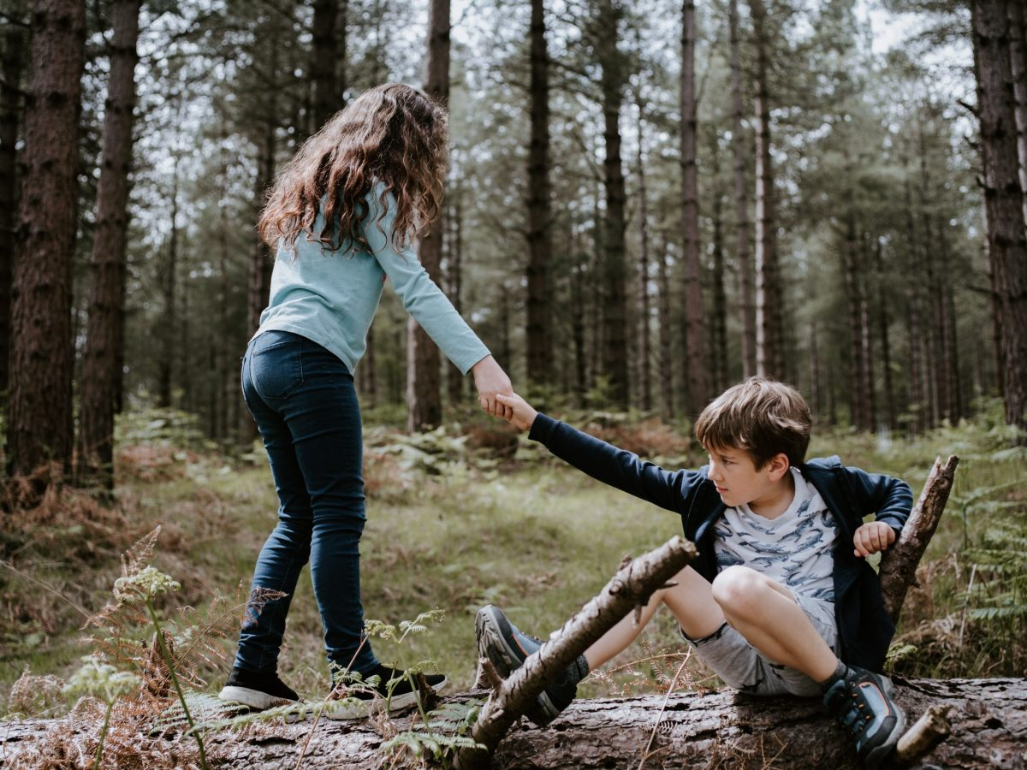
Personal, Social and Emotional Development
Early Years Expectations: Reception
Educational Programme:
Children’s personal, social and emotional development (PSED) is crucial for children to lead healthy and happy lives, and is fundamental to their cognitive development. Underpinning their personal development are the important attachments that shape their social world. Strong, warm and
supportive relationships with adults enable children to learn how to understand their own feelings and those of others. Children should be supported to manage emotions, develop a positive sense of self, set themselves simple goals, have confidence in their own abilities, to persist and wait for what they want and direct attention as necessary. Through adult modelling and guidance, they will learn how to look after their bodies, including healthy eating, and manage personal needs independently.
Through supported interaction with other children they learn how to make
good friendships, co-operate and resolve conflicts peaceably. These attributes will provide a secure platform from which children can achieve at school and in later life.
“

Slide 10
Early Years Expectations: Reception
Personal, Social and Emotional Development| Self-Regulation
Early Learning Goal: PSED | Self Regulation
Children at the expected level of development will: Show an understanding of their own feelings and those of others, and begin to regulate accordingly Set and work towards simple goals, being able to wait for what they want and control their immediate impulses when appropriate Give focused attention to what the teacher says, responding appropriately even when engaged in activity, and show an ability to follow instructions involving several ideas or actions
Progression towards the Early Learning Goal |  | Progress in other areas of self regulation – Reception
R+ | By the end of the Summer term and to be year 1 ready children should be able to…
Regulate own behaviours in order to find solutions to conflicts and rivalries To be able to read the contexts and conversation cues to be able to decide when to interrupt or to seek support from elsewhere To be able to regulate themselves to wait until what they want is available To be able to complete a task that they may set for themselves and to know when it is ‘finished’ before moving on To follow the cue for attention and follow the expectations associated with this. This would mean that when instructions are finished they are followed as part of basic school expectations. Follow instructions involving several ideas e.g time to tidy your area, get the whiteboard and pen and come to the carpet |  | To understand the potential consequences for peers should resources not be looked after appropriately
R= | By the end of the Spring term children should be able to…
To be aware of emotional support requirements for others and begin to understand the effect that they can have on others emotions To start to listen to other children or groups and wait to have their turn to speak To start initiating and negotiating with regard to sharing with their peers, modelled by adults if necessary To follow the cue for attention and follow the expectations associated with this. This would mean that fewer reminders are given and once instructions are finished they will be aware of the basic routines associated with transitions and follow these with fewer prompts. Follow simple two step instructions |  | To observe and realise that they can contribute to taking care of the resources, even if it wasn’t them that have used them
R- | By the end of the Autumn Term children should be able to…
To be able to approach an adult if they feel upset about something, seek emotional support for themselves. To be able to put their hand up and not shout out when wanting to contribute. To approach adults in an appropriate way when intervention or attention is wanted. To wait for their turn for resources and not just physically remove them To know the teachers cue for attention and follow the expectations associated with this. This may be ensuring that all children have focused attention by removing everything from their hands and turning their eyes to the teacher before teacher continues. Give reminders where needed. Follow simple one step instructions e.g. time to tidy your area |  | To understand that the resources in school must be taken care of and put away sensibly to look after them with adult guidance and explanation

Slide 11
Early Years Expectations: Reception
Personal, Social and Emotional Development| Managing Self
Early Learning Goal: PSED | Managing self
Children at the expected level of development will: Be confident to try new activities and show independence, resilience and perseverance in the face of challenge Explain the reason for rules, know right from wrong and try to behave accordingly Manage their own basic needs, including dressing, going to the toilet and understanding the importance of healthy food choices.
Progression towards the Early Learning Goal |  | Progress in other areas of PSED – Reception
R+ | By the end of the Summer term and to be year 1 ready children should be able to…
Maintain focus for a longer period of time, not be afraid to alter their approach to something to be able to succeed (e.g. choosing different equipment to build a tower or a bridge). Notice and observe if they or others break the rules and understand there will be a consequence for their actions. Can say what they have done wrong and why. Can begin to suggest what they need to do to put things right. Regulate own behaviours in order to find solutions to conflicts and rivalries Show an understanding of why exercise is important, why we need to warm up and why we need healthy food for energy and to keep our bodies healthy. To be able to compare two items of food and explain why one is better than the other for our bodies. |  | Understand the importance of keeping themselves safe by following rules in their school and home environment (e.g. crossing a road safely). Being polite to others in their everyday actions, e.g. saying hello to other members of staff. Will happily contribute within the family groups and will seek out children from other year groups within unstructured times Can hold a discussion with an unfamiliar adult about something
R= | By the end of the Spring term children should be able to…
Open to trying new activities and giving new experiences a go. Will try again if they don’t succeed the first time. Understand why we need rules and how they help to keep us safe. Can relay rules to others. Get changed for PE mostly independently (with some support fastening buttons or putting socks on) including fastening Velcro shoes. |  | Can recognise dangers in their environment and choose tools to use appropriately to stay safe. Being polite and helpful in their immediate environment. E.g. with familiar staff, peers. Can contribute within family group Can complete a busy job that involves dialogue or interaction with an unfamiliar adult
R- | By the end of the Autumn Term children should be able to…
Be able to separate from their main carer happily and come into school independently. Can take coat on and off and hang it up on their own peg. Learn and follow the school rules in different contexts (lunchtime, outdoors, in the classroom). Use appropriate manners to ask a teacher to go to the toilet, or when asking for help with clothing (putting on gloves, shoes etc). Communicate to an adult if they have had an accident/soiled themselves and ask for help to change. |  | Can keep themselves safe in their immediate environment, e.g. not running in the classroom, not climbing on furniture etc. Using manners in all contexts, e.g. please, thank you, sorry. Can do busy jobs to other areas of school alongside a familiar adult Can go to family groups alongside a familiar adult

Slide 12
Early Years Expectations: Reception
Personal, Social and Emotional Development| Building Relationships
Early Learning Goal: PSED | Building Relationships
Children at the expected level of development will: Work and play cooperatively and take turns with others Form positive attachments to adults and friendships with peers Show sensitivity to their own and others needs
Progression towards the Early Learning Goal |  | Progress in other areas of PSED – Reception
R+ | By the end of the Summer term and to be year 1 ready children will be able to
Can work with another child to complete a task, whether child led or adult directed with little direction needed from an adult In unstructured times such as breaks and lunches can play alongside others cooperating, taking turns and can solve conflict if arises Will initiate and respond to conversations from unfamiliar adults within school and is able to show them something that they are proud of and explain why Has a friendship group within the setting but sometimes chooses to work alongside others and then reintegrate without conflicts Regulate own behaviours in order to find solutions to conflicts and rivalries To be able to read the contexts and conversation cues to be able to decide when to interrupt or to seek support from elsewhere To be able to regulate themselves to wait until what they want is available. |  | Will happily contribute within the family groups and will seek out children from other year groups within unstructured times Initiates conversations with servers both within and outside of the dining hall. Can hold a discussion with an unfamiliar adult about something
R= | By the end of the Spring term children should be able to…
Can work with another child to complete a task, whether child led or adult directed direction needed from an adult In unstructured times such as break and lunch can interact with friends sometimes leading the play but also coping when the play is led by other children. Adults are sometimes needed to resolve conflict issues Will happily work with the adults familiar to them in the setting to complete tasks Has a friendship group within the setting but is able to work with other children outside of this group when directed To be aware of emotional support requirements for others and begin to understand the effect that they can have on others emotions To start to listen to other children or groups and wait to have their turn to speak To start initiating and negotiating with regard to sharing with their peers, modelled by adults if necessary |  | Can contribute within family group Is able to articulate to servers what they would like for dessert
R- | By the end of the Autumn Term children should be able to…
Can work alongside peers, sometimes interacting but consumed in own agenda In unstructured times such as break and lunch can interact with peers but this is based on their wants and needs rather than friendships, this makes peer group fluid Can separate from an adult when entering school without distress Has at least one friend whom they chose to play alongside To be able to approach an adult if they feel upset about something, seek emotional support for themselves. To be able to put their hand up and not shout out when wanting to contribute. To approach adults in an appropriate way when intervention or attention is wanted. |  | Can go to family groups alongside a familiar adult Responds to questions from servers by showing hands

Slide 13
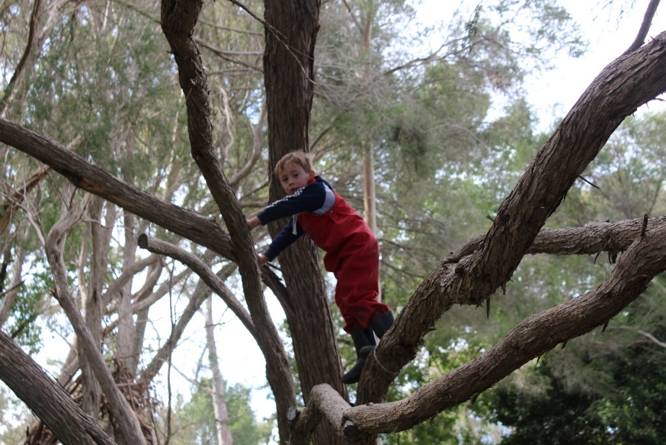
Physical Development
Early Years Expectations: Reception
Educational Programme:
Physical activity is vital in children’s all-round development, enabling them to pursue happy, healthy and active lives. Gross and fine motor experiences develop incrementally throughout early childhood, starting with sensory explorations and the development of a child’s strength, co-ordination and positional awareness through tummy time, crawling and play movement with both objects and adults. By creating games and providing opportunities for play both indoors and outdoors, adults can support children to develop their core strength, stability, balance, spatial awareness, co-ordination and agility. Gross motor skills provide the foundation for developing healthy bodies and social and emotional well-being. Fine motor control and precision helps with hand-eye co-ordination which is later linked to early literacy. Repeated and varied opportunities to explore and play with small world activities, puzzles, arts and crafts and the practise of using small tools, with feedback and support from adults, allow children to develop proficiency, control and confidence.
This Photo by Unknown Author is licensed under CC BY

Slide 14
Early Years Expectations: Reception
Physical Development | Gross Motor Skills
Early Learning Goal: Physical| Gross Motor Skills
Children at the expected level of development will:
Negotiate space and obstacles safely, with consideration for themselves and others; -
Demonstrate strength, balance and coordination when playing;
Move energetically, such as running, jumping, dancing, hopping, skipping and climbing.
Progression towards the Early Learning Goal
Progress in other areas of physical curriculum – Reception
R+ By the end of the Summer term and to be year 1 ready children should be able to…
Refine the fundamental movement skills of rolling, walking, running and skipping, crawling, jumping, hopping and climbing
Choose and use the most appropriate equipment for a game or task
Be able to play a game, understanding simple rules in pairs or small groups
Combine different movements with ease and fluency
Continue to develop an overall body strength, coordination, balance and agility needed to engage successfully with future physical education sessions and other physical disciplines including dance, gymnastics & sport
Refine a range of ball skills including: throwing, catching, kicking, passing, batting and aiming.
To confidently take part in Sports Day, enjoying team games and individual races (To begin to develop a sense of competitiveness) Children to collaborate in throwing, rolling, fetching and receiving games. To negotiate and use space together, travelling in a range of ways.
Children to develop more accurate hand/eye co-ordination in order to aim, throw, bounce, kick, catch and roll
Children can balance, jump and land appropriately from a range of equipment and heights.
To be able to balance on one leg (each leg for a short time) Children have access to weekly PE lessons that raise their heart rate Children to recognise and manage own risk and risks to others during physical activities
To sit correctly at a table with 4 legs on the floor (where appropriate)
R= By the end of the Spring term children should be able to…
Revise the fundamental movement skills of rolling, walking, running and skipping, crawling, jumping, hopping and climbing
To be able to throw and catch a large ball
Progress towards a more fluent style of moving with developing control.
Confidently use a range of large and small apparatus indoors and outside, alone and in a group
Beginning to develop an overall body strength, coordination, balance and agility needed to engage successfully with future physical education sessions and other physical disciplines including dance, gymnastics and sport
Develop a range of ball skills including: throwing, catching, kicking, passing, batting and aiming.
To have good balance and co-ordination
Can run around and avoid obstacles or other children Can throw a large ball to a partner and catch it.
To work together to make their own obstacle courses
To be able to play ring games outside in a large group, such as duck, duck, goose.
To improve confidence and control on age appropriate bikes and scooters.
Introduce some team games using balls, with simple rules. )

Slide 15
R- | By the end of the Autumn Term children should be able to…
Explore the fundamental movement skills of rolling, walking, running and skipping, crawling, jumping, hopping and climbing. Explore a range of equipment and use appropriately and safely. Respond to the instruction “To Stop” when playing games Be aware of people around them Work together safely to move equipment safely such as planks, crates and large blocks outside Being able to make large muscle movements with control. Confidently use a range of large apparatus indoors and outside, alone and in a group Explore a range of ball skills including: throwing, catching, kicking, passing, batting and aiming Use their core muscle strength to achieve a good posture when sitting at a table or on the floor. |  | Enjoy moving in a variety of ways both in PE and outdoors, on trim trails, tyre trails, wobbly bridges and made obstacle courses. To enjoy playing a range of command games such as, traffic lights, the bean game, Simon says. Ensuring they use space available safely and can make quick changes of speed and direction. To use open ended materials during physical play. To creep & crawl through a box or tunnel To use wheeled toys such as scooters, balance bikes, prams and carts. To have mastered riding a trike. To roll a ball between 2 cones. Introduce different sized balls into their play (to include things like balloons, scrunched up foil, beach balls) Can aim and throw a ball and kick it with force.

Slide 16
Early Years Expectations: Reception
Physical Development | Fine Motor Skills
Early Learning Goal: Physical Development| Fine Motor Skills
Children at the expected level of development will: Be able to hold a pencil effectively in preparation for fluent writing – using the tripod grip in almost all cases. Be able to use a range of small tools, including scissors, paint brushes and cutlery. Begin to show accuracy and care when drawing
Progression towards the Early Learning Goal |  | Progress in other areas of physical development – Reception
R+ | By the end of the Summer term and to be year 1 ready children should be able to…
Hold a pencil effectively and with good control- using the tripod grip in almost all cases. Hold a pencil close to the point. Have a preference for a dominant hand, consistently. Form recognisable letters, most of which are correctly formed. Use scissors correctly to cut around a picture along the lines. Use paint brushes with control to paint recognisable pictures. Uses cutlery effectively including cutting their food with a knife and fork. Show more accuracy and care when drawing. Draw recognisable pictures with more details e.g. a person should have a head, body, arms and legs from the body, eyes, nose, mouth, hair etc. |  | Children are able to show the skills of colouring a range of images and pictures. Children are beginning to write on a line. Children will be given the experience of sewing and woodwork Use tweezers to pick up small objects such as pompoms or marbles. Thread small beads on to a piece of sting/ wool.
R= | By the end of the Spring term children should be able to…
Begin to use a range of tools with more accuracy e.g. pencils, paintbrushes, scissors, tweezers Beginning to use a dominant hand. Begin to draw recognisable pictures. Begin to use a knife to cut their food. Confidently and safely use large and small apparatus outside. Write their names forming the letters correctly. Form recognisable letters. Dress themselves including fastening zips and beginning to fasten buttons. Go to the toilet independently and wash their hands |  | Thread small beads on to a pipe cleaner. Thread laces and ribbons through pre-made holes such as threading cards, weaving frames etc. Children are given the opportunity to work with clay. Children can use spray bottles with one hand.
R- | By the end of the Autumn Term children should be able to…
Draw lines and circles using anti-clockwise movements. Write their name. Make snips with scissors. Use a fork and spoon to eat with and begin to use a knife. Put on their own coat and fasten their zip. Dress with help. Become more independent in managing their own hygiene needs such as going to the toilet, washing hands etc. Remain dry and clean throughout the day. |  | Thread beads/ cotton reels on to a lace. Thread pasta on to a piece of string or wool. Children dance with scarves. Children can tip and pour in to containers with a small opening e.g. measuring cylinders, plastic bottles etc. Children can manipulate play dough. Children can use spray bottles using 2 hands.

Slide 17
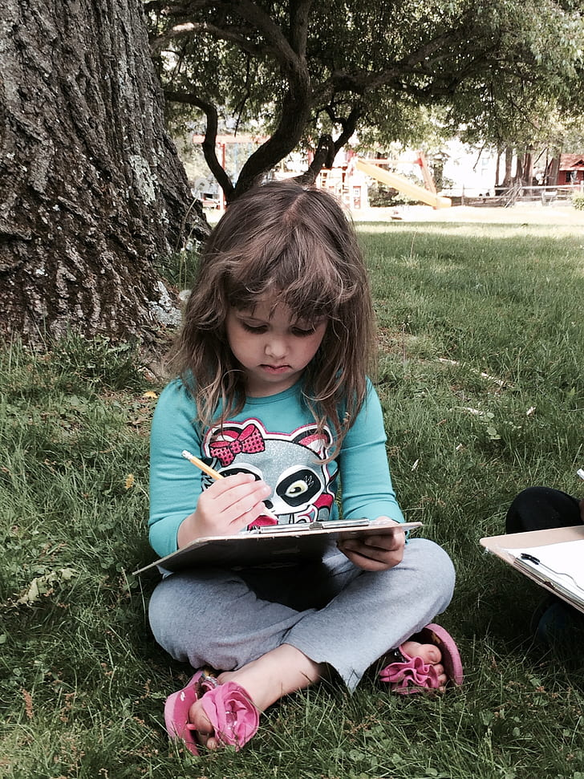
Literacy
Early Years Expectations: Reception
Educational Programme:
It is crucial for children to develop a life-long love of reading. Reading consists of two dimensions: language comprehension and word reading. Language comprehension (necessary for both reading and writing) starts from birth. It only develops when adults talk with children about the world around them and the books (stories and non-fiction) they read with them, and enjoy rhymes, poems and songs together. Skilled word reading, taught later, involves both the speedy working out of the pronunciation of unfamiliar printed words (decoding) and the speedy recognition of familiar printed words. Writing involves transcription (spelling and handwriting) and composition (articulating ideas and structuring them in speech, before writing).

Slide 18
Early Years Expectation: Reception
Literacy | Comprehension
Early Learning Goal: Literacy | Comprehension
Children at the expected level of development will:
Demonstrate understanding of what has been read to me by retelling stories and narratives using my own and recently introduced vocabulary;
Anticipate, where appropriate, events in stories;
Use and understand recently introduced vocabulary during discussions about stories, non-fiction, rhymes and poems and during role-play.
Progression towards the Early Learning Goal
Progress in other areas of literacy curriculum –Reception
R+ By the end of the Summer term and to be year 1 ready children should be able to…
Re-read books to build up their confidence in word reading, their fluency and their understanding and enjoyment
Engage in extended conversations about stories, demonstrating the correct use of new vocabulary and demonstrating their understanding by using the new vocabulary in the correct context and in conversation
Retell a familiar story/traditional tale and include repeated words, phrases and refrains correctly
Answer simple questions about a familiar book/text in shared or independent writing
Sequence four/five pictures in order – beginning, middle and end, using narrative language and new vocabulary to retell the story
Make detailed predictions about how the story might end, develop and anticipate key events within the story
Answer questions about a story and discuss the characters’ feelings
Describe the main events in stories they have read in detail
Build up a repertoire of their favourite nursery rhymes, stories songs, poems and non-fiction text
Listen attentively with sustained concentration to follow a story without pictures or props and can listen in a larger group for example in assembly
Respond to a range of texts by asking and answering appropriate questions
Engage with, and respond showing enjoyment, to a range of more challenging texts
Identify whether a word is a simple noun or another kind of word
Use expression when reading aloud, demonstrating an awareness of what a question mark and exclamation mark are
R= By the end of the Spring term children should be able to…
Read and understand simple phrases and sentences – based on their phonic ability
Engage in extended conversations about stories, learning new vocabulary
Listen to and talk about simple and topic related non-fiction books to develop a deep familiarity with new knowledge and vocabulary. (Taken from Communication & Language – Listening, attention & understanding)
Join in with and continue predictable words, phrases and refrains
Answer simple questions about a familiar book/text orally
Read and understand phrases and captions – link directly to their phonic knowledge stage of development
Describe the main events in stories they have read – beginning, middle and end in detail
Build up a repertoire of the favourite nursery rhymes and stories
Aware when they haven't understood something and are able to say, for example, 'I don’t understand'
Able to sustain attention for a given period of time depending on the situation, task or activity
They listen attentively and respond positively to a variety of assemblies
Understand simple sentences - from Phase 3 'Letters and Sounds' or equivalent
Link a story to their own lives and explain why/how

Slide 19
Sequence three pictures in order from a familiar story – beginning, middle and end, using narrative language to retell the story Make predictions about how the story might end and how the story might develop To be able to retell/join in with retelling some traditional tales |  | Use pictures/illustrations to talk about how a character is feeling Begin to use expression when reading aloud, demonstrating some awareness of what a question mark and exclamation mark are
R- | By the end of the Autumn Term children should be able to…
Understand the five concepts: print has meaning, print can have different purposes, we read English text form left to right and from top to bottom, the names of the different parts of a book, page sequencing Engage in story times. (Taken from Communication & Language – Listening, attention & understanding) Join in with predictable words, phrases and refrains Listen carefully to rhymes and songs, paying attention to how they sound. (Taken from Communication & Language – Listening, attention & understanding) Engage in non-fiction books. (Taken from Communication & Language – Listening, attention & understanding) Begin to answer simple questions about a familiar book/text orally Begin to listen to and talk about simple and topic related non-fiction books to develop a deep familiarity with new knowledge and vocabulary. (Taken from Communication & Language – Listening, attention & understanding) Understand how to listen carefully and why listening is important. (Taken from Communication & Language – Listening, attention & understanding) Retell a story, once they have developed a deep familiarity with the text; some as exact repetition and some in their own words. (Taken from Communication & Language – Listening, attention & understanding/Speaking) Listen to and talk about stories to build familiarity and understanding. (Taken from Communication & Language – Listening, attention & understanding) Begin to read and understand simple words (CVC) – link directly to their phonic knowledge stage of development Sequence three pictures in order from a very familiar and well-known story – beginning, middle and end Identify the main characters in a familiar story/traditional tale Begin to make simple predictions about how the story might end To be able to retell/join in with retelling a traditional tale – e.g., The Three Billy Goats Gruff, Goldilocks and the Three Bears and The Three Little Pigs |  | Begin to describe the main events in stories they have read with questioning to develop an understanding of the developing story – beginning, middle and end Build up a repertoire of their favourite nursery rhymes Wait for their turn to speak and respond appropriately Listen attentively in a range of situations Respond to an appropriate cue and listen attentively to the instructions given Able to sustain attention for a given period of time depending on the situation, task or activity Able to listen to stories and are able to anticipate key events by making sensible suggestions from the story read so far Understand simple sentences - from Phase 2 'Letters and Sounds' or equivalent Begin to link a story to their own lives - “ I have a brother too!” Begin to use pictures/illustrations to talk about how a character is feeling

Slide 20
Early Years Expectations: Reception
Literacy | Word Reading
Early Learning Goal: Literacy | Word Reading
Children at the expected level of development will: Say a sound for each letter in the alphabet and at least 10 digraphs; Read words consistent with their phonic knowledge by sound-blending; Read aloud simple sentences and books that are consistent with their phonic knowledge, including some common exception words.
Progression towards the Early Learning Goal |  | Progress in other areas of literacy curriculum – Reception
R+ | By the end of the Summer term and to be year 1 ready children should be able to..
Re read what they have written to check that it makes sense. Begin to read Set 2 sounds ay ee igh oo oo ar or air ou oy Begin to read some words containing these Set 2 sounds Confidently read words containing Set 1 sounds building fluency Read green or purple storybooks- matched to our Read write inc programme Read simple phrases and sentences made up of words with known letter-sound correspondences and, where necessary, a few exception words. Read common exception words matched to the school’s phonic programme – Read, Write inc. |  | Read words containing more than one syllable. Read additional Common Exception words as they come across them and retain a wider range than prescribed. Beginning to read and identify nonsense words
R= | By the end of the Spring term children should be able to…
Read Set 1 special friends sh ch th ng nk qu Begin to read some words which contain Set 1 special friends sh ch th ng nk qu Build speed of reading words containing Set 1 sounds Have a secure blending of CVC words Read short Ditty sheets and red story books- matched to our Read write inc programme Read some common exception words matched to our Read write inc programme |  | Decode words using their phonic knowledge Understand simple sentences Describe the main events in stories they have. Choose and read a range of books independently to read for pleasure and with an adult
R- | By the end of the Autumn Term children should be able to…
Understand the five concepts: print has meaning, print can have different purposes, we read English text form left to right and from top to bottom, the names of the different parts of a book, page sequencing. Develop their phonological awareness, so that they can: spot and suggest rhymes, count or clap syllables in a word, recognise words with the same initial sound, such as money and mother. Read individual letters by saying the sounds for them – m a s d t I n p g o c k u b f e l h r j v w x y z Blend sounds into words, so that they can read short words made up of known letter-sound correspondences. (Set 1 single letter sounds) |  | Demonstrate understanding when talking with others about what they have read. For example, name of characters, where the story is set, what happened in the story. Talk about what they have read. Begin to read some CVC words Knows how to hold and handle a book, turning pages and knows key parts of a book, title, cover, author, illustrator, contents page.

Slide 21
Early Years Expectations: Reception
Literacy | Writing
Early Learning Goal: Literacy | Writing
Children at the expected level of development will:
I can write recognisable letters, most of which are correctly formed;
I can spell words by identifying sounds in them and representing the sounds with a letter or letters;
I can write simple phrases and sentences that can be read by others.
Progression towards the Early Learning Goal
Progress in other areas of literacy curriculum – Reception
R+ By the end of the Summer term and to be year 1 ready children should be able to…
Write full name accurately including capital letters
Form recognisable letters, most of which are correctly formed (sequence of movement and orientation)
Write CVC words with more confidence, by segmenting the sounds and then writing the sound with letter/s Compose a sentence orally and hold it, remembering what they are going to write.
Write short sentences with words with known sound-letter correspondences.
Re-read writing to check that it makes sense.
Hold a pencil effectively and with good control, using tripod grip and holding close to point
Name the letters of the alphabet (year 1 objective)
Can write letters on the line
Use the full width of the page, writing from left to right, top to bottom.
To use finger spaces, capital letters and full stops in their writing (year 1 objective)
Write 2-syllable words containing taught sounds
To understand and use simple adjectives (colour and size) e.g. 'The black dog is in the mud.'
To write for a range of audience and purposes (postcards, letters, captions, recounts, lists…)
Beginning to write in chronological order.
Children are introduced to dictionaries, sound and word mats as a tool to support independence.
To use a tripod grip to hold a pencil.
R= By the end of the Spring term children should be able to…
Copy write full name and begin to write it from memory (forming letters correctly including capitals).
Form some lower-case letters accurately
Developing writing CVC words
To begin to write captions and phrases
To be able to write first name accurately
To sit correctly at a table with 2 legs on the floor (chair tucked in, no swinging on chair)
To hold a pencil using a comfortable grip and use it effectively.
To tilt the paper according to writing hand and hold the paper still with other hand
To know that letters have a name and letters have a sound
To know that letters can be represented by upper and lower case letters
To begin to sing the alphabet song, naming the letters of the alphabet (Year 1 objective)
Aware of syllables in words – break it up
To use capital I for personal pronoun

Slide 22
 | By the end of the Autumn Term children should be able to…
Write some letters from their name from memory.. Begin to form lower-case letters correctly as they learn them Begin to Write CVC words with support by segmenting the sounds and then writing the sound with letter/s Begin to represent some sounds correctly in their writing e.g initial sounds |  | Begin to sit correctly at a table with 2 legs on the floor (support to tuck chair in and not to swing). To hold a pencil using a comfortable grip with a little support To use the other hand to hold the paper still with support To over-write some Set 1 letters accurately, correct starting point, sequence of movement and orientation, letters on the line Aware of syllables in name – clap it out The children are exposed to a wide range of texts (story, postcards, letters, captions, signs, recounts, lists …). Aware that writing goes from left to right – adult to model

Slide 23
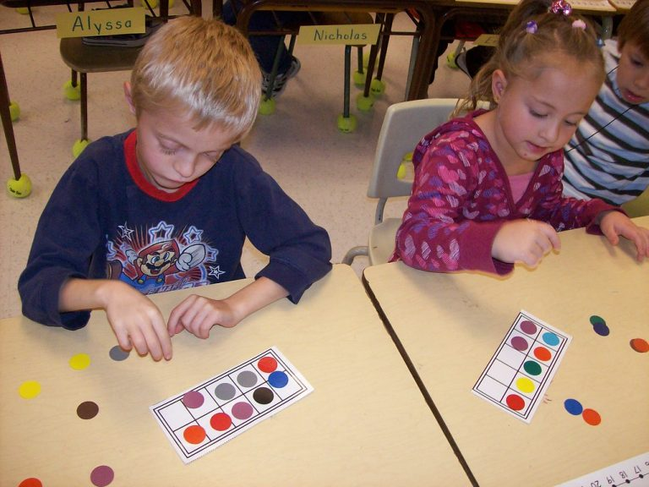
Mathematics
Early Years Expectations: Reception
Educational Programme:
Developing a strong grounding in number is essential so that all children develop the necessary building blocks to excel mathematically. Children should be able to count confidently, develop a deep understanding of the numbers to 10, the relationships between them and the patterns within those numbers. By providing frequent and varied opportunities to build and apply this understanding - such as using manipulatives, including small pebbles and tens frames for organising counting - children will develop a secure base of knowledge and vocabulary from which mastery of mathematics is built. In addition, it is important that the curriculum includes rich opportunities for children to develop their spatial reasoning skills across all areas of mathematics including shape, space and measures. It is important that children develop positive attitudes and interests in mathematics, look for patterns and relationships, spot connections, ‘have a go’, talk to adults and peers about what they notice and not be afraid to make mistakes.

Slide 24
Early Years Expectations: Reception
Mathematics | Number
Early Learning Goal: Mathematics | Number
Children at the expected level of development will: Have a deep understanding of number to 10, including the composition of each number; Subitise (recognise quantities without counting) up to 5; Automatically recall (without reference to rhymes, counting or other aids) number bonds up to 5 (including subtraction facts) and some number bonds to 10, including double facts.
Progression towards the Early Learning Goal |  | Progress in other areas of mathematics curriculum – Reception
R+ | By the end of the Summer term and to be year 1 ready children should be able to…
At all stages of EY development, planned opportunities for ‘incidental’ learning (deliberately ‘dropping in’ previous teaching and vocabulary) will support retention of facts and concepts. The focus should be on going wider and deeper (hence there is no ‘exceeding’ judgement) Where possible, links should be made (inc.through ‘continuous provision to other prime and specific areas of the EYFS Framework – and to the environment and world in general (some - but not all – links are highlighted in grey below). Number lines/tracks, real-life objects and manipulatives should be used routinely to support scaffolding and modelling. Vocabulary should be consistent and reinforced. Recognise and read numbers to 10 – including when not in order and show that they understand the relationship between them Display a deep understanding of the composition of numbers to 10, (e.g make 10 in different ways and combinations using manipulatives/objects) Display accurate 1:1 correspondence to 10 using concrete apparatus - then visually Confidently count to 10 Subitise to 10 (through the use of patterns such as numicom, ten frame, bar model)) Match numeral to quantity up to 10 – inc. out of sequence To understand 1 more and 1 less for numbers to 10 Mentally recall number bonds to 5 without apparatus and to 10 (with apparatus if needed) Calculate addition bonds and subtraction facts to/within 10 using apparatus and/or number line if needed (ie. by using 2 sets of objects) – link to 1:L1 correspondence Know that addition and subtraction are related Mentally, quickly recall all doubles to 5 (ie. double 1, 2, 3, 4, 5) Mentally, quickly recall half of 2,4,6, 8,and 10 Half of numbers 2,4,6, 8, and 10 concrete aid Doubles to 5 (double 1, 2, 3, 4, 5) concrete aid or fingers Subitise to 5 – dots on a dice, numicom piece, ten-frame, pebbles, etc, Know that = means must balance is worth the same as Solve addition and subtraction calculations when = is presented in different place (eg. 10 = 7+3 ) |  | ---------------------------------------------------------------------------------------- Make sensible estimates within 20 using subitising (estimating number of pebbles, conkers, (link to UtW) To begin to count beyond 20 Use the vocabulary (link to C&L) of addition and subtraction inc. comparison of quantities to 10 – ie. altogether, add, total, plus, more than, take away subtract, less than, fewer than, greater than, equals, the same as - in practical contexts ie. counting jumps, skips, hops, catches, turns, etc (link to PD) Recognise numerals of personal significance (ie. age, number in family, numerals on clocks,door numbers, etc), Order and compare sets of numbers up to 20 using ‘1 more than, less than, fewer’ etc. “Who did most hops/jumps/turns?– (ink to PD) Also link to clock face – (1hr after/before) (links to ‘Number Patterns – compare quantities up to 10 To begin to use numbers bonds to 10 to solve problems To begin to use a number line. To record simple addition and subtraction calculations as simple sentences with increasing confidence. Know which month/day comes before/ after a given month/day Understand largest, most, smallest, least, fewest and number in- between up to 20 –-‘Order and compare 3 objects according to length, height, mass link to SSM Say number sequences within 20 - both forwards and backwards from any number. eg 16,17,18, 13,12,11? Record their work using objects, pictures and/or diagrams Recognise the verbal abbreviation for ordinal numbers and relate this to date of own birthday (e.g 9th of May), months of year 1st, 2nd- and finishing positions in a race. Link to SSM) Link ordinal numbers to months/days of week - 1st 2nd …link to SSM Understand what makes a number odd or even using idea of one left over Begin to count in 2s within 10 – pairs of matching objects knowing when you have one left over – practical To write the digits 0 to 10 accurately To write number sequences 0-10 forwards and backwards

Slide 25
R= | By the end of the Spring term children should be able to…
Recognise and read numbers to 7 including when not in order with the aid of a number line, picture clues Accurate 1:1 correspondence concrete, visual to 7 Know that anything can be counted eg. claps, drum beats… to 7 Count an irregular arrangement to 7 Match numeral to quantity to 7 Display a deep understanding of the composition of numbers to 7 e.g make 7 in different ways (with concrete aids) Becoming more confident with the part whole model for numbers to 7 Solve addition and subtraction calculations to 10 practically and visually Find 1 more and 1 less using numbers to 7 – compare using manipulatives and number lines (links to ‘Number Patterns – compare quantities up to 10) Quick mental recall - addition facts to 7 (fingers to help) Quick mental recall - subtraction facts within 7 (fingers to help) Number bonds to 5, 6 and 7(using concrete aids to help) Know that addition and subtraction are related Subitise to 5 - dots on a die, numicom piece, ten-frame, cubes, etc. |  | Make sensible estimates using subitising within estimating number of pebbles, conkers, (link to UtW), etc.) Begin to use the vocabulary (link to C&L) of addition and subtraction in practical contexts and in discussion – altogether, add, more than, take away, subtract, more than, less than to 7 inc. comparison of quantities Begin to use ordinal numbers first, second … tenth in real life situations (eg. race results/ days of the month) (SSM) Understand largest, smallest & number in-between up to 7 Form the digits 0-7 accurately (link to 7 days in a week SSM) Say number sequences within 10 - forwards and backwards eg 4,5,6,?? 7,6,5 ?? Begin to write the digits 0 to 5 accurately Begin to write number sequences 0-5 forwards and backwards e.g 2,3,4,? 5,4,3, ??
R- | By the end of the Autumn Term children should be able to…
Recognise and name numbers 0 to 5 – when not in order Counting,1:1 correspondence to 5 - how many? Counting,1:1 correspondence to 5 – give me? Know that anything can be counted (to 5) claps, drum beats… Count an irregular arrangement to 5 Understand that zero means nothing Match numeral to quantity to 5 – concrete and visual Display a deep understanding of the composition of numbers to 5 Solve addition and subtraction calculations to 5 - practically and visually Find 1 more and 1 less numbers to 5 – using concrete and number line Addition facts to 5 (fingers to help) Subtraction facts to 5 (fingers to help) Number bonds to 2, 3 and 4 (using concrete aids to help) Subitise to 5 - dots on a die, numicom piece, ten-frame, Experiment with their own symbols and marks as well as numerals |  | Begin to understand and use ordinal numbers first, second -- in real life situations (eg. race results/position in queue) Know that a pair means two Understand and find pairs of socks, gloves, legs … (practical) Order and compare sets of numbers and quantities/objects up to 5 (UtW) Understand biggest and smallest numbers within 5 using pratical/visual aids Understand and use directional language - forwards, backwards, turn around, on top, underneath, next to.

Slide 26
Early Years Expectations:
Mathematics | Numerical Patterns
Early Learning Goal: Mathematics | Numerical Patterns
Children at the expected level of development will:
Be able to verbally count beyond 20, recognising the patterns of the counting system
Compare quantities up to 10 in different contexts, recognising when one quantity is greater than, less than, or the same as the other quantity
Explore and represent patterns within numbers up to 10, including odd and even numbers, double facts and how quantities can be distributed equally
Progression towards the Early Learning Goal
Progress in other areas of mathematics curriculum
R+ By the end of the Summer term children should be able to…
Count by rote from 0 forwards to 20 and beyond
Count by rote forwards in 1s from any number to 20 and beyond
Compare and order a variety of quantities up to 10 recognising
greater than, less than and the same as in practical context (inc.quantities)
Understand and use the vocabulary more, most, greater than, fewer, less than and equals, the same as with quantities up to 10
Recognition of odd and even numbers to 10 represented by structures e.g dots, even numbers always have a partner/pairs (made visible)
Explore odd and even numbers to 10 (represented by structures) recognising and discussing the patterns e.g odd numbers there’s always one left out and even numbers always have a partner
Count to/back in 1s from 20 – count people onto/off a queue/ add/take away single objects
Pronounce teen numbers correctly – sixteen not sixty
Count by rote in 2s forwards within 10
Count by rote in 2s to 10 - visual aid
SSM
Chant the months of the year by heart
Begin to link ordinal numbers to each month
Know which day and month comes before/ after a given day and month
Name the four seasons
Becoming aware of the analogue clock counting around the clock to 12 and recognise and read o’clock times
Becoming aware of the language associated with time (long hand, short hand, hour, minutes, clock, watch)
Compose and decompose shapes. children recognise a shape can have other shapes within it, just as numbers can
Classify and sort objects according to a criteria and begin to sort objects using own criteria (H)
Continue given repeating patterns (sound, colour, shape, objects) link to UtW
Create own repeating patterns using UtW
Order and compare 3 objects according to length, mass, capacity
Understand and use the vocabulary longer, taller, wider, shorter, narrower, heavier, lighter,
Both Number and Numerical Patterns ELG
Know that addition and subtraction are related
Automatic recall of half of numbers 2,4,6, 8, and 10
Automatic recall of doubles to 5 (double 1,2,3,4 & 5)
Recognise and calculate using coins – 1p, 2p, 5p, 10p, 20p
R= By the end of the Spring term children should be able to…
Count in 1s forwards to 20 and beyond – visual aid
Count forwards in 1s from any number (to 20) – visual aid
Count back in 1s from 20– visual aid
Say the number before and after to 10 - visual aid
Compare a variety of quantities up to 5 recognising more/greater than, fewer/less than and the same as
Understand and use the vocabulary more, most, greater than, fewer, less than and equals, the same as with quantities up to 5
Instant recall +1 -1 numbers to 20 – visual aid
Pronounce numbers correctly with support – copy me
SSM
Chant the days of the week
Know there are 7 days in a week
Know which day comes before/ after a given day
Know which days are the weekend

Slide 27
Both Number and Numerical Patterns ELG Know that addition and subtraction are related – using concrete aids or fingers |  | Know what day it is today, yesterday, tomorrow Chant the months of the year with support Know which month your birthday is in Understand general time of day and chronology of day in school and at home (develop vocab: morning, lunch, tea, hometime, bed etc) Understand position through words – eg. “The bag is under the table,” – with no pointing (under, on top, next to, behind, in front) (PDev – PE – move under) Name and describe common solid shapes cube, cuboid, Use the language solid, face, edges Sort objects using two criteria e.g Sort solid shapes straight edges, curved edges Find something bigger than, smaller than, taller than, shorter than, heavier, lighter, deeper…link to UtW Find something the same size, equal to (length, weight, capacity)link to UtW Continue a simple repeating pattern e.g red, blue, red … apple, banana, apple … Notice and correct an error in a repeating pattern To talk about money using the terms, pennies, pence, change, amount To read price tags up 1p, 2p, 5p,10p
R- | By the end of the Autumn Term children should be able to…
Count by rote forwards and backwards to 10 – visual aid (counting children, counting objects in areas) Hold fingers up correctly for each number to 10 Count on and back in 1s from any number to 10 – visual aid and fingers Know by heart the number before and after numbers to 5 Chant rhymes involving numbers |  | SSM Chant the days of the week with support Begin to know what day it is today Begin to know what day it is tomorrow Sort objects using a given criteria e.g big, small, heavy, light (link to UtW) Name and describe common flat shapes circle, square, rectangle, triangle Use the language flat, sides and corners Classify and sort objects into sets according to given criteria, areas in classroom with labels, block area, pencils into colours, buttons e.g colour, shape, holes in centre, Copy a given pattern (sound, colour, shape, objects - )e.g clap, clap, click… red, blue, red … apple, grape, orange… square, triangle, square … (link to UtW) Use templates/ stencils as patterns to produce an identical image e.g draw around stencils and templates Copy given pictures/patterns from resources (both natural and manmade e.g conkers, twigs, leaves, inset shape patterns, block area make a model from given picture(link to UtW) Understand position through words and real scenarios, pictures – for example, “The bag is under the table,” (under, on top, next to, behind, in front) link to PD (PE – ‘under the bench/on top of the mat --) Discuss simple routes – forwards, backwards, turn, corner (outdoor provision) Begin to describe a sequence of events, real or fictional, using words such as ‘first’, ‘then.. Pay for items in role play shop using pennies Know that coins are collectively called money and we spend them, save them

Slide 28
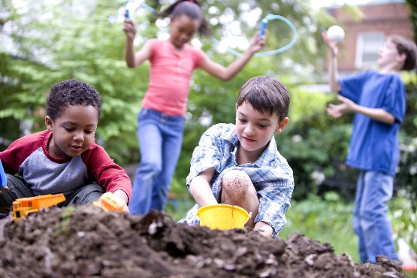
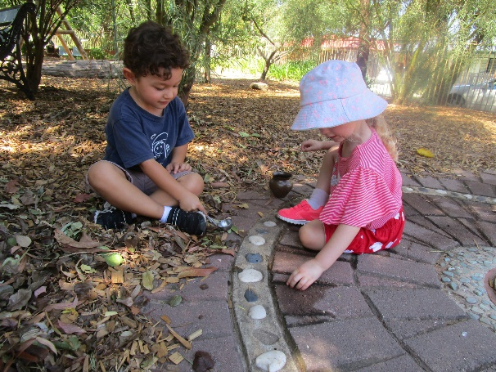
Understanding the World
Early Years Expectations: Reception
Educational Programme:
Understanding the world involves guiding children to make sense of their physical world and their community. The frequency and range of children’s personal experiences increases their knowledge and sense of the world around them – from visiting parks, libraries and museums to meeting important members of society such as police officers, nurses and firefighters. In addition, listening to a broad selection of stories, non-fiction, rhymes and poems will foster their understanding of our culturally, socially, technologically and ecologically diverse world. As well as building important knowledge, this extends their familiarity with words that support understanding across domains. Enriching and widening children’s vocabulary will support later reading comprehension.

Slide 29
Early Years Expectations: Reception
Understanding the World | Past and Present
Early Learning Goal: Understanding the World | Past and Present
Children at the expected level of development will: Talk about the lives of the people around them and their roles in society; Know some similarities and differences between things in the past and now, drawing on their experiences and what has been read in class; Understand the past through settings, characters and events encountered in books read in class and storytelling;
Progression towards the Early Learning Goal |  | Progress in other areas of past and present – Reception
R+ | By the end of the Summer term and to be year 1 ready children should be able to…
Children are able to compare the present and the past, drawing on the knowledge they have established in the classroom as well as their own personal experiences -e.g. comparing toys now and then. To share stories from the past– then and now past and present |  | Children can make links between the past and the present in everyday contexts, for example yesterday we did PE today we are going outside.
R= | By the end of the Spring term children should be able to…
Begin to make sense of their own life-story and family’s history: Children can retell what their parents told them about their life story and family history in brief. Look at a childhood photograph from a parents familiar event (birthday, Christmas, school start) – what is the same what is different to their own Children know that some things stay the same and some things change as we grow up |  | To read versions of a story with the same story line and compare the characters and settings within the book. Children can use past and present vocabulary in their everyday language
R- | By the end of the Autumn Term children should be able to…
To look at a personal family photograph of a familiar event (birthday, Christmas, school start) including themselves and describe the situation it shows Talk about members of their immediate family and community: Children share and discuss pictures of their family and listen to other members of the class. To understand and talk about being similar and different to each other. Children begin to develop positive attitudes about the differences between people. To know about some key events that happen in the autumn term, e.g. Remembrance day, bonfire night or other topical events and where they come from. Children further develop their knowledge of key roles in society such as Doctors, Nurses, Police Offices etc, and extend this to encompass our own personal responsibility -i.e. what we can all do to help society (recycling, saving energy, etc) |  | . Children understand the concept of past and that it has happened, can talk about events in the past like what they did at the weekend or their last birthday

Slide 30
Early Years Expectations: Reception
Understanding the World | People, Culture and Community
Early Learning Goal: Understanding the World |People, Culture and Communities
Children at the expected level of development will: Describe their immediate environment using knowledge from observation, discussion, stories, non-fiction texts and maps; Know some similarities and differences between different religious and cultural communities in this country, drawing on their experiences and what has been read in class; Explain some similarities and differences between life in this country and life in other countries, drawing on knowledge from stories, non-fiction texts and – when appropriate – maps.
Progression towards the Early Learning Goal |  | Progress in other areas of people and communities – Reception
R+ | By the end of the Summer term and be year 1 ready children should be able to…
Name places of local importance to the community, drawing on their own experiences where possible Children can talk about the features of the places that they are familiar with and can begin to describe how they are different to other places. Children are able to utilise the vocabulary needed to describe the people, places and communities they are discussing |  | Children use maps and pictures to draw local places of interest to them Write postcards/ letters to post using addresses to ensure that they arrive
R= | By the end of the Spring term children should be able to…
Develop their knowledge of the celebration of special times from around the world and where these take place locally, including the buildings- children engage further with religious and cultural communities and their practices throughout the curriculum at appropriate times of the year – i.e. Chinese New Year, Pancake Day and The Easter Story. Children can talk about the similarities differences they notice between people across different communities/ family groups |  | Children enjoy making maps of their local area including key features such as their own house local shop etc
R- | By the end of the Autumn Term children should be able to…
Children are able to describe their immediate environment and are able to use new vocabulary where appropriate and draw their version of the immediate environment Children begin to develop an understanding of different religious occasions from around the world. – i.e. Diwali and Christmas For the children to investigate our local area/community To know about some key events that happen in the autumn term, e.g. Remembrance Day, Bonfire night etc |  | Know key people within school, their names and their job in school Compare houses that they can see, what are similarities and differences Know some important people from the immediate community and what they do to help the community

Slide 31
Early Years Expectations: Reception
Understanding the World | The Natural World
Early Learning Goal: Understanding the World | The Natural World
Children at the expected level of development will:
Explore the natural world around them, making observations and drawing pictures of animals and plants.
Know some similarities and differences between the natural world around them and contrasting environments, drawing on their experiences and what has been read in class.
Understand some important processes and changes in the natural world around them, including the seasons and changing states of matter.
Progression towards the Early Learning Goal Progress in other areas of science curriculum – Reception
R+ By the end of the Summer term children should be able to…
Make observations of their local area, animals and plants.
Talk about the different seasons.
Can link different types of weather to different seasons.
Talk about changes of states such as freezing and melting.
Understand changes in the natural world such as day and night.
To be able to describe different materials and textures.
To begin to understand the properties and uses of different materials.
The environment is conducive to scientific experimentation, exploration and development of vocabulary e.g. floating and sinking, magnets, ramps, exploring materials and textures, growing plants, etc.
A wide range of scientific topics are covered throughout the year such as sun and moon, space, hot and cold, minibeasts, life cycles etc.
Children can name the main parts of a plant i.e. leaf, stem, petals
Children can name some plants and animals found in their local environment.
Children are giving opportunities to explore the environment around them such as visits to the local park, walks around their local area, opportunities to explore the outdoor environment.
R=
By the end of the Spring term children should be able to…
Children investigate light travelling through transparent materials, shadows.
Children can name different materials e.g. wood, plastic, metal, fabric, glass etc.
Draw information from simple maps e.g. land and sea.
Talk about some life cycles and draw these stages with support.
Describe what they can see, hear and feel when outside.
Explore the natural world around them.
Understand the effect of changing seasons on the natural world around themselves e.g. that leaves change colour in autumn that the trees are bare in winter, etc.
Draw pictures of plants using the correct colours and including specific parts (leaves, flowers etc) .
Show care and concern for living things.
To talk about why some things happen e.g. melting, freezing, floating, sinking etc.

Slide 32
R- | By the end of the Autumn Term children should be able to…
Understand the need to show respect for animals and the natural world. Identify similarities and differences in the natural world. Explore different materials. Talk about the differences between materials.. Talk about things they have observed. Identify and name different types of weather/seasons Explore different scientific experimentations eg. Magnets, ramps, floating and sinking etc. |  | Children investigate ice melting, floating and sinking etc. Children can talk about and explore the different senses.

Slide 33
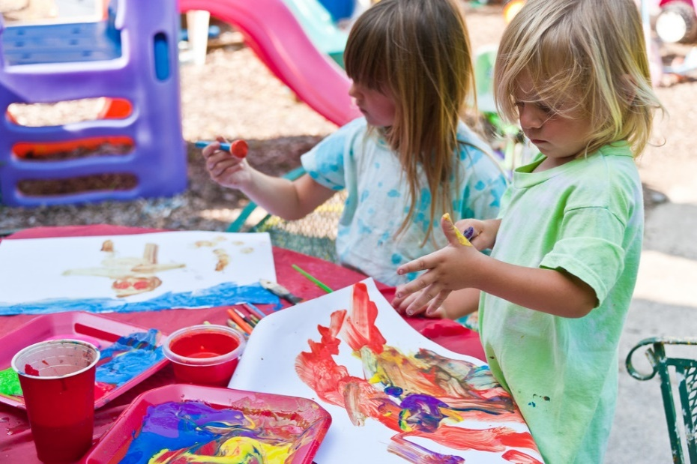
Expressive Arts and Design
Early Years Expectations: Reception
Educational Programme:
The development of children’s artistic and cultural awareness supports their imagination and creativity. It is important that children have regular opportunities to engage with the arts, enabling them to explore and play with a wide range of media and materials. The quality and variety of what children see, hear and participate in is crucial for developing their understanding, self-expression, vocabulary and ability to communicate through the arts. The frequency, repetition and depth of their experiences are fundamental to their progress in interpreting and appreciating what they hear, respond to and observe.

Slide 34
Early Years Expectations: Reception
Expressive Arts and Design | Creating with Materials
Early Learning Goal: Expressive Arts and Design | Creating with Materials
Children at the expected level of development will: Safely use and explore a variety of materials, tools and techniques, experimenting with colour, design, texture and form Share their creations, explaining the process they have used Make use of props and materials when role playing characters in narratives and stories
Progression towards the Early Learning Goal |  | Progress in other areas of curriculum – Reception
R+ | By the end of the Summer term and to be year 1 ready children should be able to…
Come up with their own design briefs to solve problems including making props and scenery for imaginative play Be able to talk through from designing to building what they have used and why they have chosen to use that resource or technique Be able to use shapes and colour to express emotions within creations Create collaborative creations sharing ideas , resources and skills for specific purposes including to complement role play |  | Be able to draw a face containing the main parts of a face and for it to reflect themselves Explore making colours lighter and darker by adding black and white to make colours lighter and darker
R= | By the end of the Spring term children should be able to…
Begin to follow a ‘design brief’ given by the teacher to create models and pictures using a range of resources Choose the most appropriate way to make their idea following a ‘design’ that they have produced to meet a given purpose Go back to their designs and improve these building on their previous learning Explore ways of joining materials for different purposes Draw with increasing complexity including beginning to add additional shapes for detail |  | Explore colour mixing from the primary colours to make new colours Know the three primary colours and begin to recreate art by well-known artists
R- | By the end of the Autumn Term children should be able to…
Create pictures and models using a range of resources from their own ideas Be able to talk about what they have made and why they have made it Explore a range of materials in their environment and make things with these, describing why they have chosen what they have chosen. Create closed shapes with continuous lines and begin to use these shapes to represent objects |  | Hold a pencil using a comfortable grip and explore different pencil types Begin to make observational drawings linked to the world around them

Slide 35
Early Years Expectations: Reception
Expressive Arts and Design | Being Imaginative and Expressive
Early Learning Goal: Expressive Arts and Design | Being Imaginative and Expressive
Children at the expected level of development will:
Invent, adapt and recount narratives and stories with peers and their teacher;
Sing a range of well-known nursery rhymes and songs; Perform songs, rhymes, poems and stories with others, and – when appropriate – try to move in time with music.
Progression towards the Early Learning Goal Progress in other areas of Being Imaginitive curriculum – Reception
R+ By the end of the Summer term and to be year 1 ready children should be able to…
Singing: Singing:
Able to sing a song / rhyme that has been taught – pitch and melody matching appropriate to the age of the child
Able to perform a simple poem (as part of a group), able to follow the rhythm of the poem
Invent own simple songs and rhymes – based on known versions
Sing a known song to an audience
Musical Knowledge and Skills:
Musical Knowledge and Skills:
Know the names of key musical instruments available to them – maraca, tambourine and triangle
Listen to a range of music and begin to compare it – ‘they sound a bit similar because they both have lots of quiet sounds’.
Begin to know types of music which they like (e.g. pop, classical, Jazz)
Able to make own simple repeating compositions (clapping / body percussion / instrument)
Able to copy a simple beat pattern X X - - X – including with instruments
Able to play an allocated instrument(s) as part of a planned musical composition
Dance:
Able to move in time with music to partake in a simple dance routine, with repetitive dance motifs
Imaginative Narrative:
Use free choice props and small world artefacts to create or adapt a narrative or story, mirroring some vocabulary, or themes from the stories they have experienced.
As part of a group, invent or adapt a known story to create a new narrative
Dance:
Create own simple dance motifs in response to music – using props / costumes as appropriate
Imaginative Narrative:
Can retell a story to an audience, using simple prompts / reminders if required
R= By the end of the Spring term children should be able to…
Singing:
Singing:
Able to pitch match in simple call and response tasks
Able to sing taught songs with melody matching
With support, adapt simple songs and rhymes
Perform a known rhyme to an audience
Musical Knowledge and Skills:

Slide 36
Know which instrument to use for a desired effect – e.g. sleigh bells for Santa, Use appropriate vocabulary to describe these sounds. Able to use instruments to match a simple taught rhythm and able to make up own musical patterns Dance: Children afforded the opportunity to freely respond to music through dance and the use of simple props (e.g. scarves, a ribbon) Children move to a beat – matching movements to the rhythm Imaginative Narrative: Use free choice props and small world artefacts to retell aspects of a story that has been experienced several times, mirroring some vocabulary from the story, with support from an adult. |  | Musical Knowledge and Skills: Listens to a range of music types express a preference and justify it with a simple statement ‘I don’t like that music because it is too loud’. Dance: Begin to create own dance motifs with support Imaginative Narrative: Retell a story as part of a group performance
R- | By the end of the Autumn Term children should be able to…
Singing: Know the difference between singing and shouting Able to join in with songs that have been taught Join in with the taught nursery rhyme/number rhyme for this term Musical Knowledge and Skills: Explore and play with a range of musical instruments – being able to match the sound to the instrument following play opportunities. Describe these sounds (rattle, loud bang, bells etc) Listens to a range of music types – recognise that they are different and express a preference Dance: Copy a simple taught dance to music – watching and matching Children able to freely respond to music through dance Children recognise the value of costume in a dance presentation Imaginative Narrative: Join in with refrains from stories Use pre-selected props and small world artefacts to retell aspects of a story that has been experienced several times, with prompting support from an adult. |  | Singing: Enjoy singing songs and rhymes – demonstrated by having favourites Memorise the songs and rhymes taught Take part in our Christmas performance – singing as part of a group to an audience Musical Knowledge and Skills: Recognise and clap the syllables in words – in preparation for pulse work Dance: Take part in our Christmas performance – dancing / moving as part of a group to an audience Imaginative Narrative: Able to choose an object and make up simple statements about it (e.g. a stick could be a magic wand that belongs to a fairy, a snake that has died, a witches finger!)

Slide 37
Reception Tracking Support
Our curriculum is the progression model. If the curriculum is well planned and progressive – and children learn the planned curriculum, then they are making progress – they know and remember more. As such, our tracking for children across is early years is simple… are they learning the planned curriculum? And if not, at what point are they up to?
A child who is learning the planned curriculum as expected would simply follow:
By Christmas | R- | A child who has kept pace with the planned curriculum by the end of the year , would achieve the national Early Learning Goals
By Easter | R=
By End Of Year | R+
Using this methodology, a child who enters reception with typical levels of knowledge and skill expected for their age would be baselined as N2+ (meeting the demands of the N2 curriculum). Children who are not displaying age appropriate skills can be assessed at any point on the scale opposite. In essence, each ‘grade’ represents a term’s worth of curriculum content. The OFSTED – and Trust - expectation is that most children who enter below, but not significantly below, should catch up with good teaching.

